Slide 1


Azure Cosmos DB for PostgreSQL Technical Deep Dive
<speaker name>
<title>
<month year>

Slide 2
AGENDA
Overview - Cosmos DB For PostgreSQL (Powered by Citus)
Cluster Manageability
Data Distribution
Data Modeling
Querying (with App Patterns)
Performance Tuning
Monitoring & Alerting
Troubleshooting
Programming (App Stacks/ORM)
Migration Consideration
New UX post Relaunch

Slide 3




Azure Cosmos DB for Postgres
A fully managed relational distributed database preserving ACID capabilities of SQL realm alongside enterprise proven, global distribution & elasticity of Azure Cosmos DB.
Distributed Postgres
Global Scalability
Parallelized performance
Break free from the limits of single-node Postgres & scale out across 100s of nodes
Global availability of data through Cross-region replicas
Ingest & query your database in real time, with sub-second responses across billions of rows
Ideal for SaaS
Common Source for
OLTP & OLAP
Stay current with PostgreSQL innovations
Easier implementation both for Building for Scale or Building for Isolation with finer control on individual shards.
Save time & cost. Run both transactions and analytics in one database. Also, avoid the painful costs of manual sharding
Developed as an open source extension (not a fork), leverage all your PostgreSQL expertise and its latest innovations
Notes:
Detailed documentation for available Citus INBUILT functions
https://docs.microsoft.com/en-us/azure/postgresql/hyperscale/reference-overview

Slide 4

Fully Managed Distributed SQL build upon Open Source PostgreSQL
Distributed Scale
Zero Data Loss HA
Global replication
Extensions
Rich indexing
JSONB
Independent Compute & Storage
Easy ecosystem integration
Geospatial support
Full text search
Parallelized performance
Security
Compliance

Slide 5
Overview

Slide 6
Linearly Scaled Throughput
Delivers 2 Million NOPM with 20 nodes cluster having 64 vcores each
Sample Hammer DB TPC-C Benchmarks
250000
215,464
200000
166,426
NOPM
New Orders Per minute
150000
100000
94,938
50000
43,796
c-8 + 2*w-8
c-8 + 4*w-8
c-8 + 6*w-8
c-8 + 8*w-8
2-node cluster
4-node cluster
6-node cluster
8-node cluster
Cluster Size
Notes:
Online Rebalancing essentially provides customers with additional control of rearranging tenants / shards across different nodes, utilizing the system defined balancing strategies or self defined custom strategies as well.
Covered in more detail in data modeling and rebalancing section

Slide 7
Elastic compute & Storage options
Scale Vertically up or down
104 cores
Independent Compute
Scale Out ---->
2 cores
128 GB
Number of Nodes
Independent Storage
16 TB
This model allows you to independently choose compute and storage resources.
Best for customers who value flexibility - control and transparency
Notes:
Scaling the storage or compute are independent operations.
We could vertically scale as well as scale out either 1 node or multiple nodes added at a time.

Slide 8

Azure Cosmos DB for Postgres Availability
Azure managed service available for PostgreSQL 14
New
PostgreSQL 14 Available
30 September 2021
01 October 2021
1 day availability

Slide 9
Online Scaling (Powered by Citus)
Start Building apps on Single node
Seamlessly scale to Multiple nodes
Notes:
To achieve distributed scale Azure cosmosdb for postgres extends Postgres with the super power of distributed tables:
You can start small by building your apps on a single node, the same way you would with PostgreSQL.
As your app’s scale and performance requirements grow, you can seamlessly scale to multiple nodes by transparently distributing your tables.

Slide 10
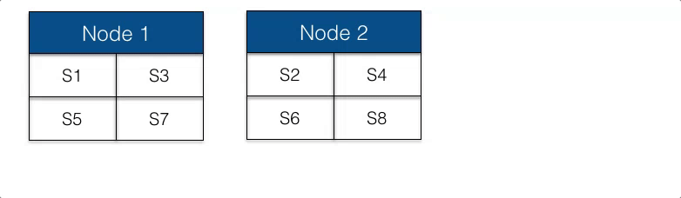
Online Tenant Isolation
Isolating a tenant allows allocating dedicated resources to handle growing needs for an individual tenant.
SELECT isolate_tenant_to_new_shard('table_name', tenant_id);
SELECT master_move_shard_placement(shard_id, source_node_name, source_node_port, target_node_name, target_node_port);
Notes:
Inbuilt ability to have more control and flexibility in their environment, with pre-identified step to separate larger \ higher utilized tenants.
It enables SaaS providers to reassure customers that—even in a multi-tenant environment—their resources cannot be accessed by other tenants.
Additionally, it limits impact of failures with no impact of disruptions, caused due to a tenant on other ones.

Slide 11


Private access through
Private Link
VNet Peering
VMNET-EUS
US EAST
No Access to Internet
Azure VM
PGVMNET-EUS
US EAST
Azure VM
10.1.3.4
PaaS
US WEST
Private Endpoint Connection
Azure VM
VNET Gateway
VNET Gateway
VNet2VNet
P2S, S2S VPN Express route
On-Premises
Notes:
In motion: Only TLS 1.3
At-rest: Always encrypted with AES-256 cypher [in Azure Storage]​
Private Link Support​
Row level security – native PostgreSQL RLS works! Steps to enable RLS - https://www.drware.com/row-level-security-in-azure-database-for-postgresql-hyperscale/

Slide 12
Simplified Management
Automatic shard distribution with Multi-node set up
1
Free backup storage with PITR up to 35 days
2
Columnar storage for higher level of compression
Notes:
Inbuilt functions added by the Citus extention removes lots of complexities in performing the distribution or compression operation in most effective ways.

Slide 13
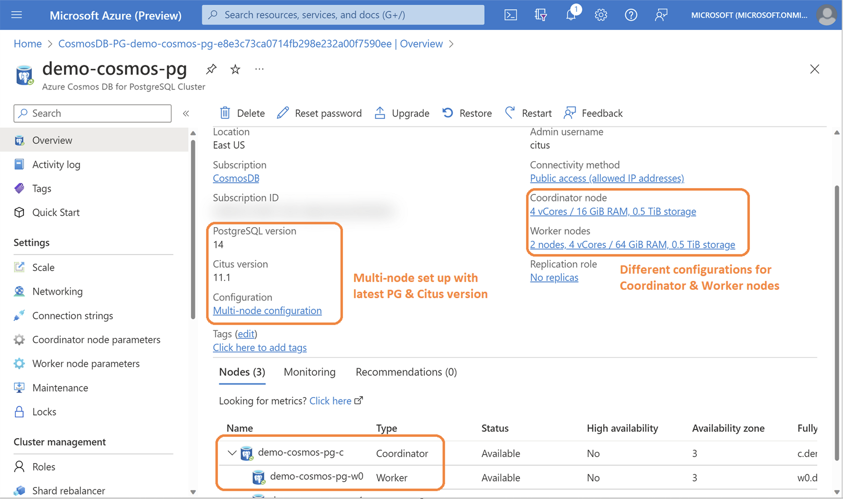
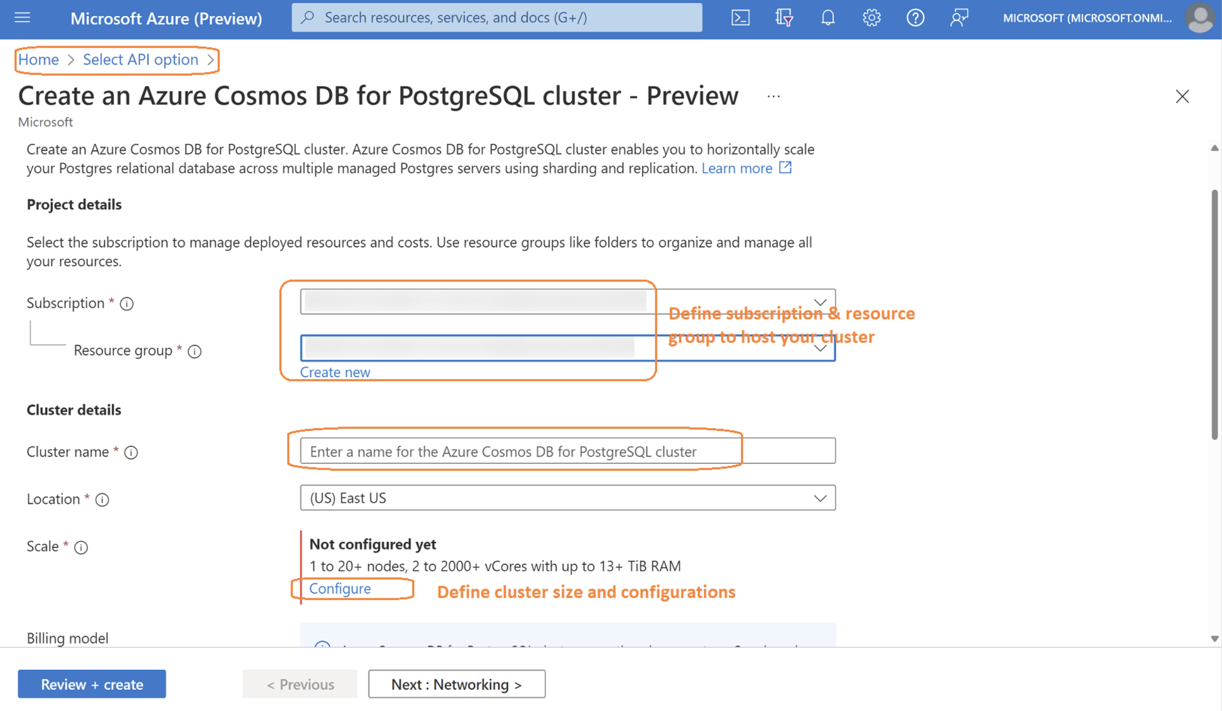
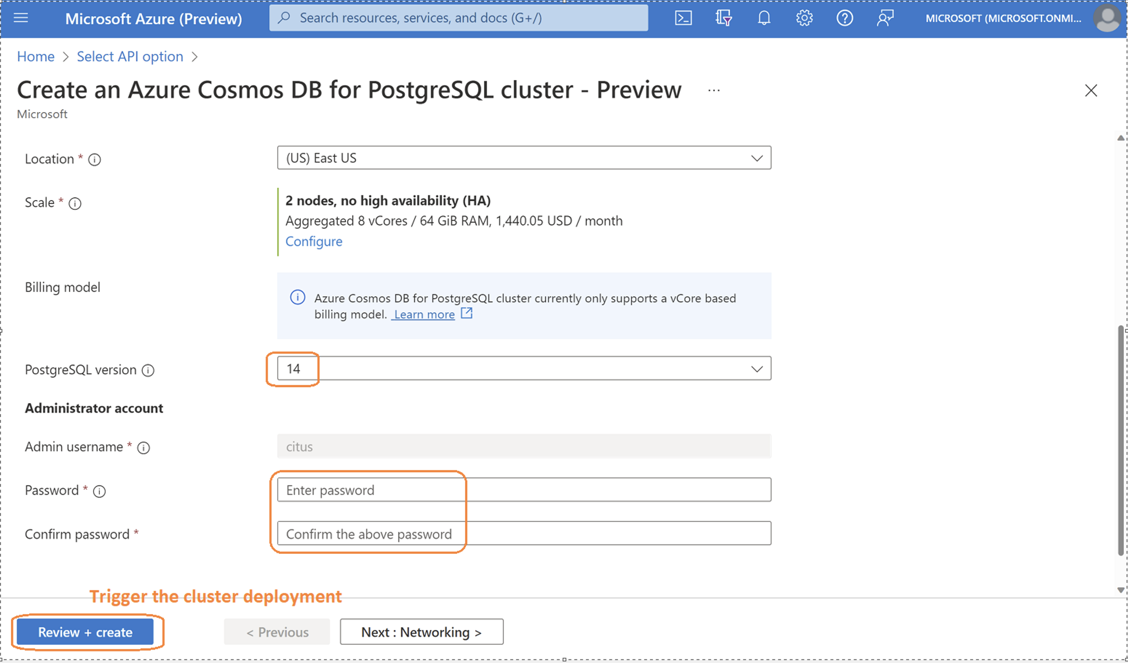
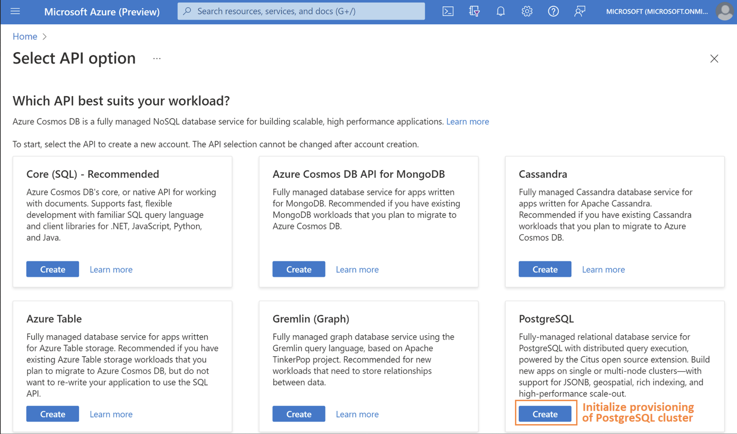
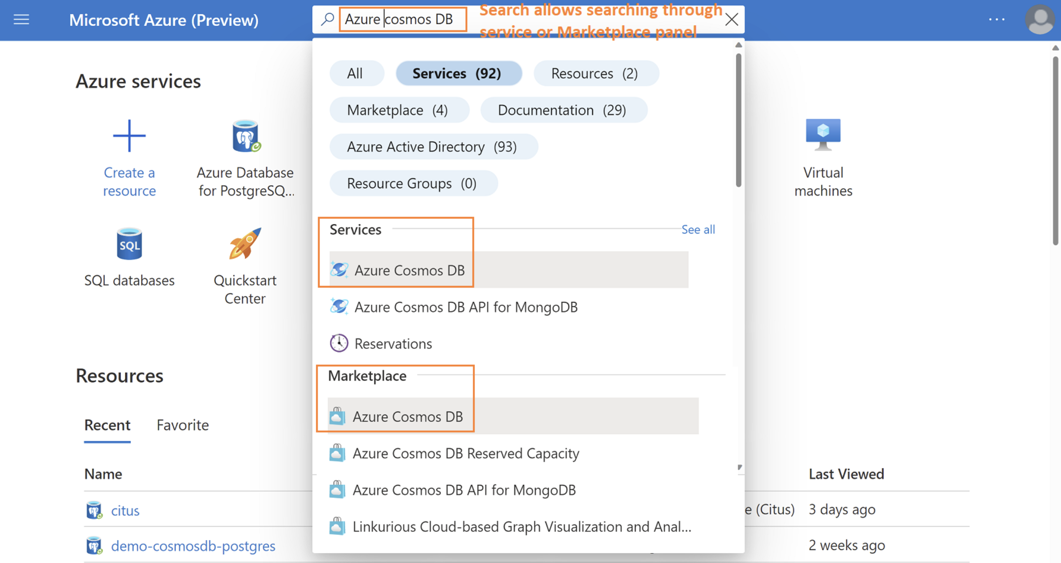
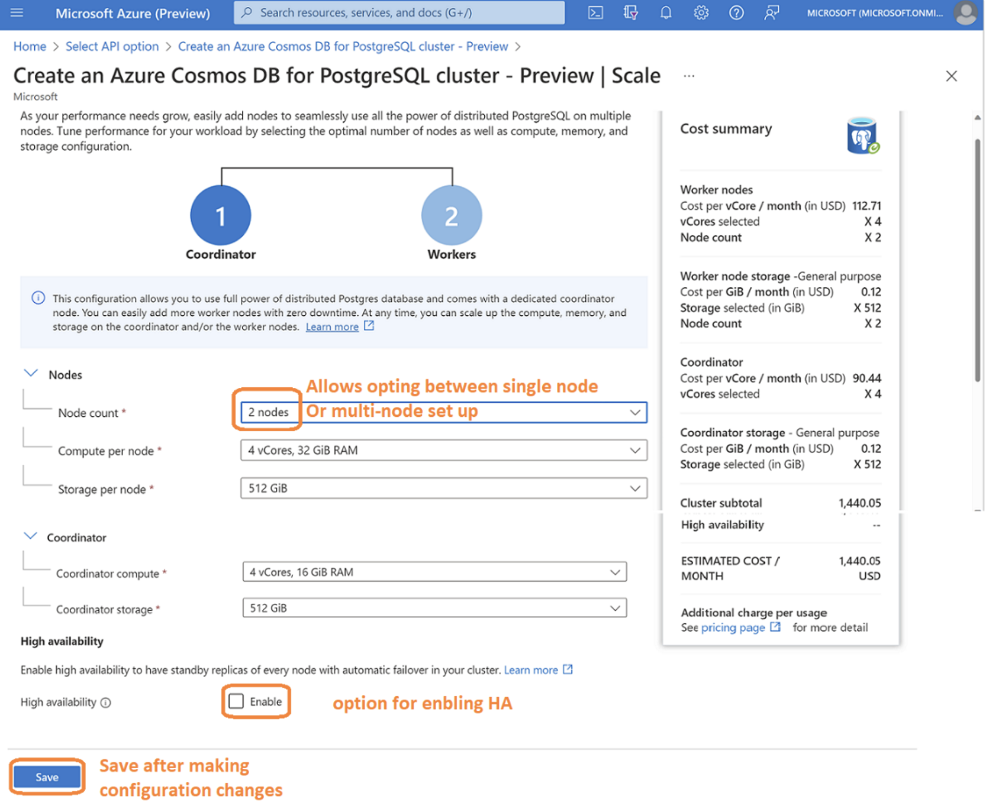
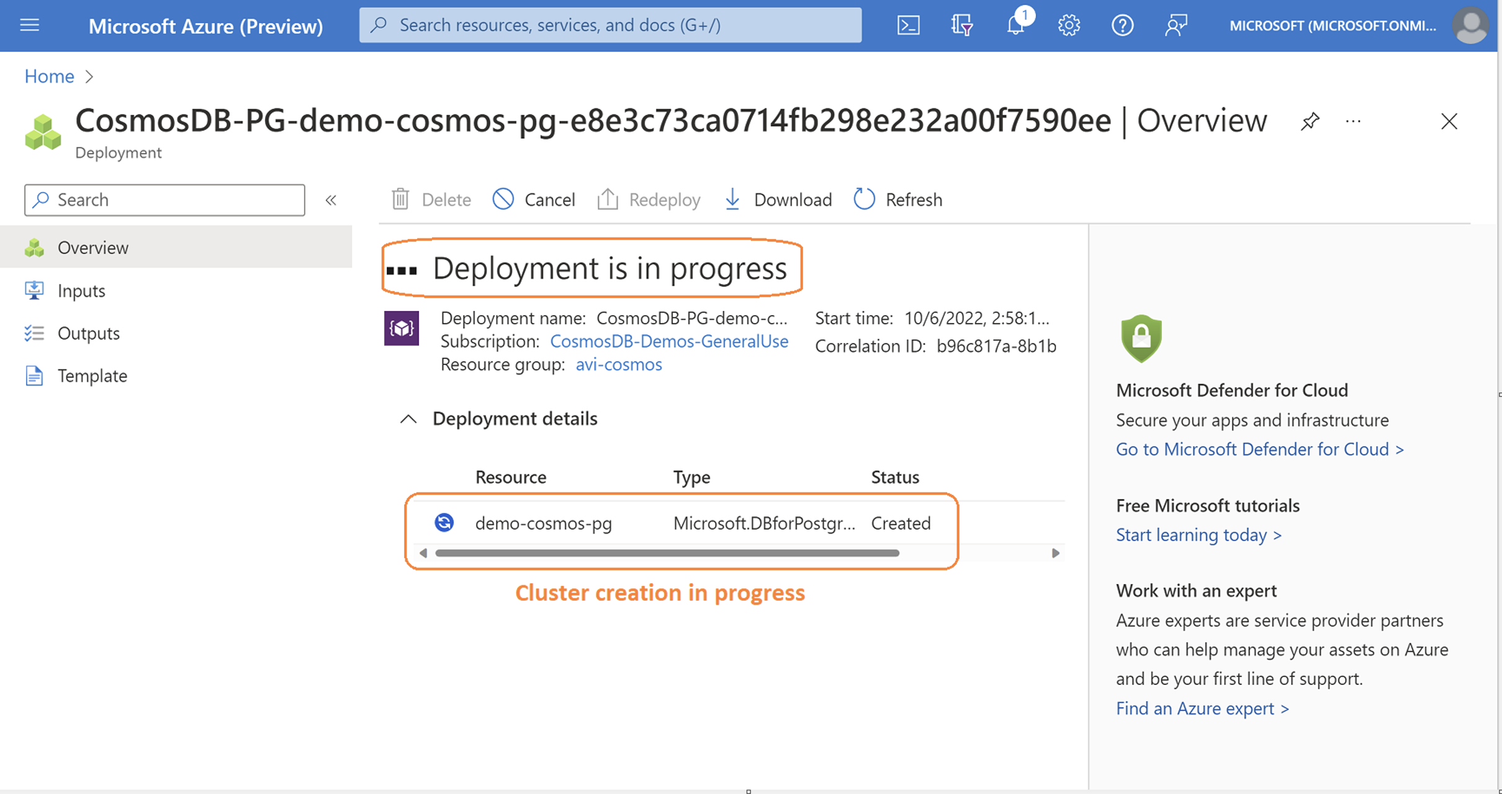
Goals in Power BI
Portal Access
Driven by data
Built for teams
AI powered
Automated action
Notes:
This is a guided preview of navigating the portal for provisioning the PostgreSQL cluster. Each page is configured to flip after 5 secs.

Slide 14
Architecture Overview
High Availability
Postgres sync replication
Reads & Writes
Worker node 0
Worker node 0’s standby
Application
Reads, Writes
&
DDL
Postgres sync replication
PostgreSQL client
Coordinator
Coordinator’s
standby
Reads & Writes
Postgres sync replication
Worker node 1
Worker node 1’s standby
Azure Region
Notes:
Cross – Region replicas are also supported with similar set up but replication set up is Asynchronous (Expected to have minor lags).

Slide 15
Data Distribution & Terminology
Coordinator Node
Node with metadata information, typically helping with routing DDLs
Worker Node
Nodes which store data in form of shards
Shard
A smaller subset of table rows on worker
NODE 1
NODE 2
Coordinator node
Metadata Tables & Functions
Metadata Tables & Functions
Metadata Tables & Functions
Shard 1
Shard 31
Shard 2
Shard 41
Shard 3
Shard 51
Internal connections
Internal connections
Internal connections
Notes:
INSERT, UPDATE, DELETE, SELECT can be routed to any node & will be served by node containing the actual data.
Distribution happens with hashing of distribution key and at the backend keeping separate ranges or buckets for storing the shards.
1 shard could map to n distribution values.
1 node could host “m” number of shards for same table.
More shards could help with faster ingestion rates and also help with easier vacuuming of tables. Ideal for highly transactional systems or IOT based systems.
Analytics query may perform better with somewhat limited shards, typically 2-4 shards per node. Allowing for dedicated connection and hardware. Analogy to this is, Copying files on windows where we observe 100,000 smaller files being less performant than 100 files, both being of same size.

Slide 16
Data Distribution
/* Create Postgres table */
CREATE TABLE SalesTxn
(
SalesTxnID int
CustomerID bigint
Date datetime
Amount decimal(19,4)
)
SalesTxn
SalesTxnID int
Date datetime
Amount decimal(19,4)
CustomerID bigint
Local table created on coordinator
/* Inbuilt Automatic Online Sharding */
SELECT create_distributed_table_concurrently
(
‘SalesTxn’ , -- Table_name
‘CustomerID’ -- Shard Key
)
SalesTxn_111
SalesTxnID int
Date datetime
Amount decimal(19,4)
CustomerID bigint
SalesTxn_112
SalesTxnID int
Date datetime
Amount decimal(19,4)
CustomerID bigint
SalesTxn_113
SalesTxnID int
Date datetime
Amount decimal(19,4)
CustomerID bigint
SalesTxn_114
SalesTxnID int
Date datetime
Amount decimal(19,4)
CustomerID bigint
SalesTxn_142
SalesTxnID int
Date datetime
Amount decimal(19,4)
CustomerID bigint
…………………..
Notes:
create_distributed_table accepts <Table_name>,<Shard_key>,<shard count>,<collocate with>
SELECT create_distributed_table(‘Table_1’, ‘ShardKeyID', shard_count:=8, colocate_with:='another_table’);
Default shard count = 32
Co-locate helps with grouping multiple related tables to be distributed together with common data ranges. This improves the performance multi-folds by avoiding any joins to be done across different nodes.

Slide 17
Data Distribution (Node level)
SELECT create_distributed_table_concurrently
(
‘SalesTxn’ , -- Table name
‘CustomerID’ -- Shard Key
)
Coordinator node
NODE 1
NODE 2
NODE 3
NODE 4
SalesTxn_111
SalesTxnID int
Date datetime
Amount decimal(19,4)
CustomerID bigint
SalesTxn_119
SalesTxnID int
Date datetime
Amount decimal(19,4)
CustomerID bigint
SalesTxnID int
Date datetime
Amount decimal(19,4)
CustomerID bigint
SalesTxn_127
SalesTxn_135
SalesTxnID int
Date datetime
Amount decimal(19,4)
CustomerID bigint
SalesTxn_118
SalesTxnID int
Date datetime
Amount decimal(19,4)
CustomerID bigint
SalesTxn_126
SalesTxnID int
Date datetime
Amount decimal(19,4)
CustomerID bigint
SalesTxn_134
SalesTxnID int
Date datetime
Amount decimal(19,4)
CustomerID bigint
SalesTxn_142
SalesTxnID int
Date datetime
Amount decimal(19,4)
CustomerID bigint
Distribution\Shard key – Column (CustomerID in above) used to distribute data among nodes
Notes:
By default, equal number of shards gets distributed across individual nodes being part of the cluster.
Example, 4 worker node cluster, will distribute 32 shards equally – 8 shards on each node.

Slide 18
Common development scenarios
Real-time data analytics
Customer facing dashboards need to
provide sub-second responses
Enterprise HTAP application
Common app types
e-Commerce app
Multi-tenant app
Analytics sites
Finance
Gaming/voting
Sales\Marketing app
…and many others
IOT based apps
Multi-tenant SaaS
SaaS app grows fast & need to scale
while still providing snappy experience
$

Slide 19

Real-time / timeseries operational analytics and reporting
Azure Cosmos DB for PostgreSQL
Interactive analytics dashboard: Need to visualize and query data, with sub-second latency.
Highly concurrent needs : Provide access to lots of concurrent users querying the dashboard at the same time.
Demanding performance expectations: Your users need sub-second response times for queries (sometimes millisecond response times) even when handling hundreds of analytical queries per second.
Data needs to be “fresh”: Your users need to query the data while you’re simultaneously ingesting new data, this is the “real-time” bit.
Event or time series data: Your data captures the many things that have happened (events) along with their associated timestamps, and you want to analyze the data.
1
2
4
Devices
Event Hubs
Raw Events
Azure Databricks
3
Scheduled
process
5
4
Browser
App Service
Aggregations
6
Notification Hubs

Slide 20
Choosing a shard key for real-time analytics & timeseries workloads
Shard Key Criteria
Pick a column that enable queries to be parallelized across the cluster, columns having:
high cardinality as the distribution column
even distribution i.e. lesser skew
present in the GROUP BY clause—or are queried as list of values
For timeseries data, Use sharding in combination with native Postgres partitioning
Use reference tables to enable JOINs
Pitfalls to Avoid
Do not choose a timestamp as the shard key, in timeseries use case.
Why? Data is preserved is based on hash value of distribution key (and not on the distribution key value itself. Results in skew on data towards single shard.
Notes:
In a time-series workload, applications query recent information while archiving old information.
The most common mistake in modeling timeseries information in Citus is using the timestamp itself as a distribution column. A hash distribution based on time will distribute times seemingly at random into different shards
rather than keeping ranges of time together in shards. However, queries involving time generally reference ranges of time (for example the most recent data), so such a hash distribution would lead to network overhead.
Real-time queries typically ask for numeric aggregates grouped by date or category. Citus sends these queries to each shard for partial results and assembles the final answer on the coordinator node. Queries run fastest when as many nodes contribute as possible, and when no single node must do a disproportionate amount of work.

Slide 21







Scaling multi-tenant & SaaS applications
Tenants need isolation : Your SaaS customers only need to read/write their own data and should not have access to data from your other SaaS customers.
Application is growing fast: Your application is growing fast, in terms of
number of users, size of database, or amount of activity—hence the number of monthly active users (MAU) or daily active users (DAU) is increasing.) More specifically, your database is 100s of GBs and growing, your SaaS app has 1000s of customers, you have 100,000+ users (or more.)
Performance issues, especially with concurrency : You’re starting to run into performance issues during times with lots of concurrency.
Single digit millisecond latency : Multi-tenant SaaS apps are primarily operational/transactional, with single digit millisecond latency requirements for their database queries
Want to keep relational database semantics: You don’t want to give up foreign keys for referential integrity, nor give up things like database constraints or secondary indexes. So the cost of migrating to a NoSQL data store to get scale is just not worth it to you.
Tenant (customer)
Azure Cache
for Redis
2
Training & Predictive Experimentation
1
3
4
Data from multiple sources
Azure Kubernetes Service
Azure Cosmos DB for PostgreSQL Aggregations
Azure Machine Learning
6
PostgreSQL Power BI Connector
Consumers
Notification Hubs
5
Power BI

Slide 22
Choosing a shard key for Multi-Tenant
SaaS workloads
Shard Key Criteria
Pick a column that enable queries to be parallelized across worker nodes
Partition distributed tables by a common tenant_id column
Convert small cross-tenant tables to reference tables, example country table.
All application queries to include the distribution column.
Pitfalls to Avoid
Tables larger than 10 Gb are mostly observed unsuitable as reference table as a rule of thumb.
Highly transactional table being kept as reference table.
Notes:
Concept of colocation (covered in querying section) is the key here.
Common instances include company, account, organization, or customer. The column name will be something like company_id or customer_id.
Examine each of your queries and ask yourself: would it work if it had additional WHERE clauses to restrict all tables involved to rows with the same tenant id?

Slide 23
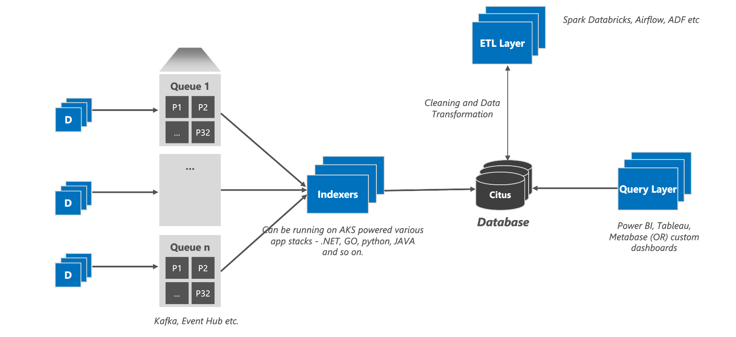
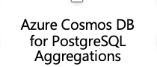
IOT workloads – needing a transactional database
Need for an RDBMS and leverage PostgreSQL features – To leverage SQL expressiveness, support UPDATE/DELETE workloads, ACID etc. Also leverage unique PostgreSQL features such as JSONB, PostGIS (geospatial) and so on.
Large numbers of devices: we’ve seen customers with tens of thousands of devices, as well as millions of devices.
Need real-time, high-throughput ingest: In order to manage what’s going on with your fleet of devices, you need the data now. Which means you need a database that can ingest and write with high throughput and low-latency. Example: 2 billion measurements per hour, which equates to roughly ~500,000 measurements ingested per second.
Query response times in the single digit second or milliseconds: Whether you are managing wind farms or manufacturing devices or fleets of smart meters, one sign that your IOT application could benefit from Azure Cosmos DB for PostgreSQL is when your users need their query responses (on fresh data) in the single digit seconds or even in milliseconds.
Run NoSQL/document style workloads, but require PostgreSQL features such as transactions, foreign/primary keys, triggers, extension like PostGIS, etc.

Slide 24
Choosing a shard key for IOT Workloads
Shard Key Criteria
Distribute large tables on a common column that is central piece of the app, and the column that your app mostly queries.
As IOT apps have a time dimension, partition your distributed tables based on time. You can use native Azure Cosmos DB for PostgreSQL time series capabilities to create and maintain partitions.
Partitioning helps efficiently filter data for queries with time filters.
Expiring old data is also fast, using the DROP vs DELETE command.
Use the JSONB datatype to store semi-structured data. Device telemetry data is typically not structured.
If your IoT app requires geospatial features, you can use the PostGIS extension, which Azure Cosmos DB for PostgreSQL supports natively.
Pitfalls to Avoid
Tables larger than 10 Gb are mostly observed unsuitable as reference table as a rule of thumb.
Highly transactional table kept as reference table.
Notes:
Need to refine the criteria specifically to IOT & possible loopholes to avoid
https://docs.microsoft.com/en-us/azure/postgresql/hyperscale/quickstart-build-scalable-apps-model-high-throughput

Slide 25
High-throughput transactional apps
Primarily transactional application: Your app is primarily transactional in nature, with creates, reads, updates, and deletes—without the need for many complex queries.
Semi-structured data like JSON: The objects you’re managing are semi-structured formats like JSON (which Postgres has robust support for.)
Single key: Your workload is mostly based on a single key, which you just have to create, read, update, and delete. (Therefore the majority of your transactions will only need to go to a single shard in the distributed Citus cluster.)
High throughput: Your throughput requirements are demanding and cannot be met by a single database server, on the order of 1000s or 10s of thousands of transactions per second.
Need relational database features: Some teams use NoSQL key-value stores for these types of semi-structured data-intensive workloads—but if you find yourself unwilling to go to NoSQL because there are relational database features you need, then Hyperscale (Citus) might be a good fit. Examples of key relational database features you might want to retain are strong consistency (not that eventual consistency compromise), foreign keys for referential integrity, triggers, and secondary indexes.
5
4
Browser
App Service
Azure Cache
for Redis
3
1
2
Azure Cosmos DB for PostgreSQL
Browser
Event Hubs
6
Azure Databricks

Slide 26
Choosing a shard key for
Transactional / Operational Workloads
Shard Key Criteria
Pick a column that application filters on most of the times (over 80% of the times) – WHERE clause filter on the column
Ex: SELECT * FROM events where device_id=1;
Avoids network/connection overhead, as query hits only one worker where distribution column exists – important for transactional workloads.
If there is no such key, slight modification to below parameter should help
Adaptive executor is optimized to reduce network/connection overhead.
Can explicitly citus.max_adaptive_executor_pool_size to 1.

Slide 27
Shard Key Selection Summary
Multi-tenant – “Column that is at the top of hierarchy OR the one that identifies the tenant”​
Use foreign key graph and joins​
Real-time Operational Analytics – “Common column that co-locates large tables”​
Use foreign keys and joins​
High Throughput Transactional– “Column that the application mostly filters on”​
Use WHERE clause filters

Slide 28
Data Modelling

Slide 29
Table Types in Azure Cosmos DB for PostgreSQL
Distributed Table
A table split into multiple shards spread across multiple nodes.
Typical size > 10 GB
Reference Table
A table that is placed on all nodes in a Citus cluster.
Typical size < 10 GB
Local Table
Tables that are created for administrative sections of your application, typically stored on coordinator
Notes:
Distributed tables which requires Joins are typically split using common field or key, to keep the data collocated. This enables local \ faster joins.

Slide 30
Data Modeling
Example:
Multi-Tenant
e-commerce store
Category​
category_id​
category_type​
expiry_applicable
Stores​
store_id​
name​
category​
Reference tables
Distributed tables
products​
product_id​
store_id​
name​
description​
price​
category_id
orders​
order_id​
store_id​
status​
address
ordered_at​
Tax_id
line_items​
line_item_id​
product_id​
order_id​
store_id​
quantity​
line_amount​
Taxation
Tax_id​
Tax_desc
tax_rate
Store_id appears as the tenant identifier.
It’s available in 3 tables allowing collocating these tables together
Line_items would be joined against the order table often & thus requires same distribution as orders table.
Add field store_id
Backfilling the line items with store_id allows even distribution of set across all 4 tables
Notes:
The stores table is at the top of the hierarchy.
products & orders are associated to store.
line_items is associated to orders, and indirectly comes lower in store hierarchy.
address & category are master tables, required in Joins to specific tables only, & are smaller in size. These are ideal candidates we choose as REFERENCE table

Slide 31
Multi-Tenant data placement
Application view
Internal Management in Database
Worker Node 1
Product_id | Store_id | ….
1 | 1
2 | 1
3 | 2
4 | 4
5 | 3
6 | 1
Shard 1
Shard 2
Store_id | ….
1
Product_id | Store_id | ….
1 | 1
2 | 1
6 | 1
Store_id | ….
4
Product_id | Store_id | ….
4 | 4
Worker Node 2
Worker Node 3
Store_id | ….
1
2
3
4
Shard 3
Shard 4
Store_id | ….
2
Product_id | Store_id | ….
3 | 2
Store_id | ….
3
Product_id | Store_id | ….
5 | 3
Distribution Key : Store_id, thus we can see data distributed for different tenants being stored into separate shard.
NOTE : All 4 tables on previous slide will have same data placement based on store_id
Notes:
Colocating tables by store has advantages:
Provides SQL coverage such as foreign keys, JOINs. Transactions for a single tenant are localized on a single worker node where each tenant exists.
Achieves single digit millisecond performance.
Queries for a single tenant are routed to a single node instead of getting parallelized, which helps optimize network hops and still scale compute/memory.
It scales. As the number of tenants grows, you can add nodes and rebalance the tenants to new nodes, or even isolate large tenants to their own nodes. Tenant isolation allows you to provide dedicated resources.

Slide 32
Multi-Tenant Rebalancer
Worker Node 1
Worker Node 4
-- As store sales increases for stores we can scale out the cluster in following steps :
Step 1 : Provisioning an additional worker node through portal.
Step 2 : Trigger shard rebalancer
-- Data from Node 1 will be moved to Node 4
SELECT master_move_shard_placement(
shard_id, source_node_name, source_node_port, target_node_name, target_node_port);
Note: By default Shard rebalancer balances equal number of shards over the cluster without any parameters
Shard 1
Shard 2
Store_id | ….
1
Product_id | Store_id | ….
1 | 1
2 | 1
6 | 1
Store_id | ….
4
Product_id | Store_id | ….
4 | 4
Worker Node 2
Worker Node 3
Shard 3
Shard 4
Store_id | ….
2
Product_id | Store_id | ….
3 | 2
Store_id | ….
3
Product_id | Store_id | ….
5 | 3
Notes:
Previous slide showed both Shard 1 & Shard 2 being part of worker node 1. With growing need for Store 1, we moved out shard 2 to separate node of its own leaving worker node 1 resources solely available to Store 1.

Slide 33
Data Modeling (Multi-Tenant)
Querying Scenarios :
Pull details for an order placed to a store. (Single shard query hits one node)
SELECT * FROM orders WHERE order_id = 123 and store_id = 3;
Product category offered across stores (Parallelized search & Co-located data aggregation)
SELECT product_id, category_id, s.name, count(*) FROM products p
JOIN stores s on p.store_id = s.store_id
GROUP BY product_id, category_id, s.name;
Look for product within a store \ brand (Single node Query with aggregation)
SELECT count(*) FROM products p
JOIN stores s on p.store_id = s.store_id
WHERE store_id = 123;
Identify sales for given Store (Single node multi-shard query)
SELECT s.store_id, count(distinct p.product_id), count(distinct o.order_id)
FROM products p
JOIN stores s on p.store_id = s.store_id
JOIN orders o on s.store_id = o.order_id
WHERE store_id = 123
GROUP BY s.store_id;
Notes:
Identify sales for given Store
We can host data for store_id = 123 into multiple shards

Slide 34
Data Modeling (HTAP / Timeseries application)
Query scenarios :
Verify number of devices across a region.
SELECT COUNT(1) FROM Devices
WHERE ST_WITHIN(ST_MakePoint(lat, lon), YOUR_BOUNDARY_GEOM);​
Review device health by monitoring device specific events.
SELECT COUNT(1) FROM Devices d
JOIN Events e ON d.device_id = e.device_id
WHERE d.device_id = ‘123’;
Analyze device events within geography
SELECT event_type,eventstate,COUNT(1) FROM Devices d
JOIN Events e ON d.device_id = e.device_id
WHERE d.device_id = ‘123’ and ST_WITHIN(ST_MakePoint(lat, lon), YOUR_BOUNDARY_GEOM)​
GROUP BY event_type,eventstate;
Review specific event types
SELECT event_type, Count(device_id) FROM Events
WHERE created_at > current_date - interval '7 days’
GROUP BY event_type;
>1 billion events
Millions of devices
Events​
id​
device_id​
ip_address​
created_at​
updated at​
device_type​
event_state​
event_type​
detail (jsonb)​
Devices​
device_id​
device name​
lat​
lon
country​_id
detail (jsonb)​
Distributed table
Country​
country_id​
country_name​
total_area
Reference Table

Slide 35
Postgres Partitioning post Sharding
Events​
id​
device_id​
Ip address​
Created_at​
Updated at​
Device_type​
Event_state​
Event_type​
Detail (jsonb)​
In addition to sharding the tables on device_id and Co-locating devices and users table, another level of distribution could be achieved through partitioning.
Core benefits of the approach is to limit the query to latest data
Easy archival of the dataset
Easier management through Scheduling with Pg_cron for activities such as indexing, vacuuming of datasets
events_jan_2022​
id​
device_id​
Ip address​
Created_at​
…​
events_feb_2022​
id​
device_id​
Ip address​
Created_at​
…​
events_march_2022​
id​
device_id​
Ip address​
Created_at​
…​
SELECT create_time_partitions( table_name := 'Events', partition_interval := '1 month', end_at := now() + '12 months' );
………..

Slide 36
Parameter tuning for specific workload
citus.max_adaptive_executor_pool_size : Total number of connections that a single query (cross shard) can generate per worker node.​ If there are performance issues with higher concurrency, try to reduce this to smaller number. Low value
like 1 or 2 for transactional workloads with short queries (<20 ms) should help.
citus.task_assignment_policy : Affects queries with reference table access by choosing to read data in round robin manner. Reducing load on single worker node.
citus.explain_all_tasks : Details, all tasks generated in execution plan.
citus.max_intermediate_result_size : The maximum size in KB of intermediate results for CTEs or sub-queries that are unable to be pushed down to worker nodes for execution. Network becomes bottleneck if intermediate result is large. The default is 1GB.
citus.node_connection_timeout : Sets the maximum duration (in milliseconds) to wait for connection establishment. This GUC affects connections from the coordinator to workers, and workers to each other. Default : 30 secs.
citus.max_cached_conns_per_worker : Each backend opens connections to the workers to query the shards. At the end of the transaction, the configured number of connections is kept open to speed up subsequent commands. Increasing this value will reduce the latency of multi-shard queries.
Notes:
More configuration properties could be referred here : https://docs.citusdata.com/en/v11.0/develop/api_guc.html
citus.use_secondary_nodes = ‘always’ -- planner will query only nodes which are marked as ‘secondary’
SET citus.node_connection_timeout = 60000; -- 60 sec GUC sets the maximum duration (in milliseconds) to wait for connection establishment. affects connections from the coordinator to workers, and workers to each other.

Slide 37
Online Rebalancer Powered By Citus
Adding a new node to cluster doesn’t trigger rebalancing by default.
Shard rebalancer redistributes shards across old and new worker nodes for balanced data scale-out
Shard rebalancer will recommend rebalance when shards can be placed more evenly
For more control, use tenant isolation to easily allocate dedicated resource to specific tenants with greater needs
Azure Cosmos DB for Postgres Cloud Shard Rebalancer
Node 1
Node 3
Node 2
Node 4
Unaffected Shard
Shard to be moved (Source)
Shard being moved (target)
Successfully moved shard
Notes:
Online Rebalancing essentially provides customers with additional control of rearranging tenants / shards across different nodes, utilizing the system defined balancing strategies or self defined custom strategies as well.
https://docs.citusdata.com/en/v11.0/develop/api_metadata.html#rebalancer-strategy-table

Slide 38
Data Distribution Strategy
SELECT rebalance_table_shards(rebalance_strategy := 'by_shard_count'); (Default Strategy)
Node 1
Node 2
Node 1
Node 2
1
2
3
4
5
6
1
2
4
5
Node 3
Node 3
3
6
Notes:
https://www.citusdata.com/blog/2021/03/13/scaling-out-postgres-with-citus-open-source-shard-rebalancer/

Slide 39
Data Distribution Strategy
SELECT rebalance_table_shards(rebalance_strategy := 'by_disk_size');
Node 1
Node 2
Node 1
Node 2
4
5
5
4
1
2
1
2
There is flexibility for users to create self defined custom strategies through UDFs
Notes:
https://docs.citusdata.com/en/stable/develop/api_metadata.html_gl=1*1y4sz3y*_ga*MTc3MjY3OTQ2LjE2NTcyNzY2NTk.*_ga_DS5S1RKEB7*MTY1OTUyMjA0Mi4xMi4wLjE2NTk1MjIwNDIuMA..#rebalancer-strategy-table

Slide 40
Query Patterns

Slide 41
Shard Creation
WORKER NODES
WORKER NODES
W₁
Distributes tables across the cluster
CREATE TABLE campaigns_101
CREATE TABLE
campaigns_104
APPLICATION
Decorative
W₂
CREATE TABLE campaigns (…);
SELECT create_distributed_table( 'campaigns','company_id', shard_count:= 48);
CREATE TABLE campaigns_102
CREATE TABLE
campaigns_105
METADATA
COORDINATOR NODE
CREATE TABLE campaigns_103
CREATE TABLE
campaigns_106
W_{3 …} W_{n}
Notes:
Create distributed table command splits (shards) data across multiple nodes. Each is a smaller table\shard holding a set of your total data

Slide 42
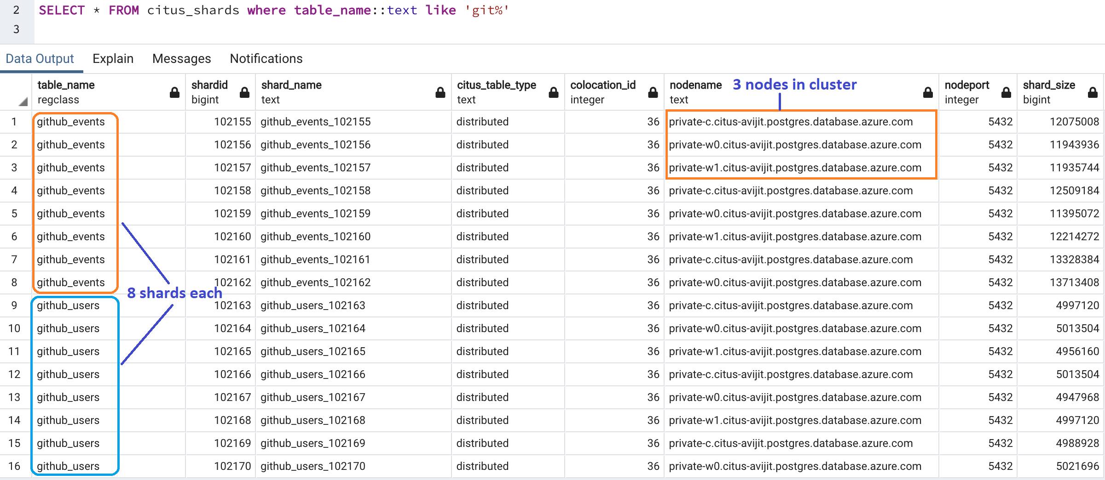
Sample table shards
SELECT create_distributed_table_concurrently('github_users’,’event_id’, shard_count:= 8);
SELECT create_distributed_table_concurrently('github_events’,’event_id’, shard_count:= 8);
Notes:
8 shards have been distributed as 3,3 & 2 across the 3 nodes as shown in above screenshot.

Slide 43
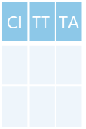
Query with Filter
Query issued on shard key
SELECT
Route to Node based on shard key filter
Individual node executes query
PostgreSQL
Database
Connection
APPLICATION
Coordinator
Coordinator node determines which node owns the shard and routes the query
Query is executed on the worker node that owns the specific shard
Server Group
Worker Nodes
Shards
CI | TT | TA
CI | TT | TA
…
CI | TT | TA
COORDINATOR NODE
1
2
8
9-16
17-24
25-32
PostgreSQL Hyperscale (Citus) Server Group
Query executed against a single shard
Notes:
Distribution of queries. Example –
Query hits coordinator
Coordinator sends sub queries to workers.
Workers compute and sends data back to coordinator which sends the result back to the application
Result : Optimized resource usage and increased performance.

Slide 44
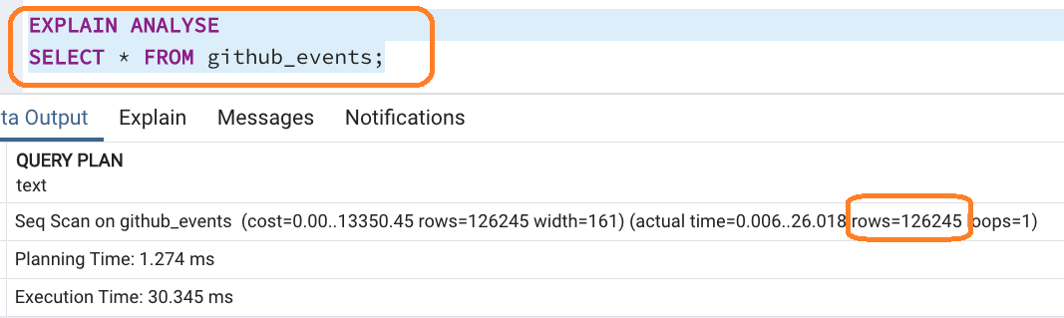
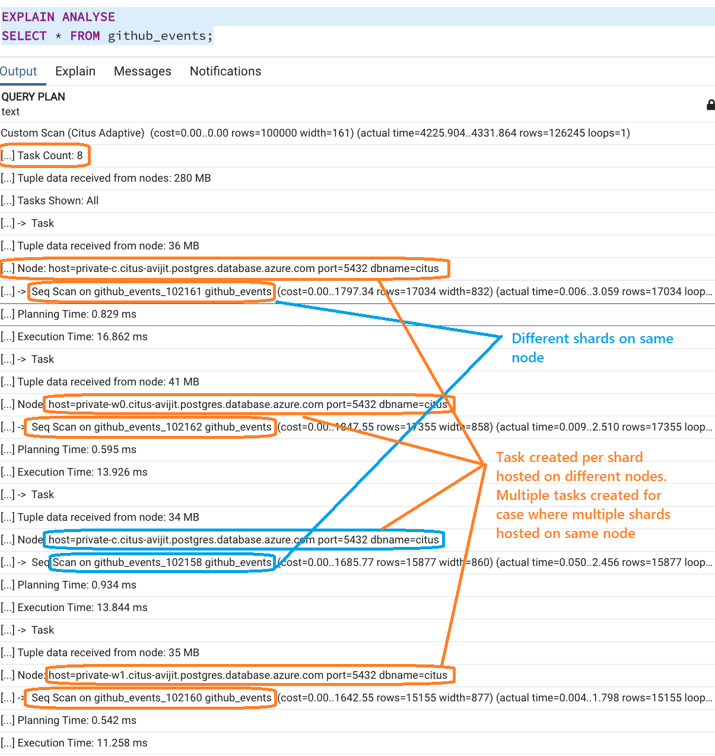
Query plan
Single node native Postgres
Azure Cosmos DB for PostgreSQL (Multi-Node)
All data resides on same node, resources available on single node gets allocated

Slide 45
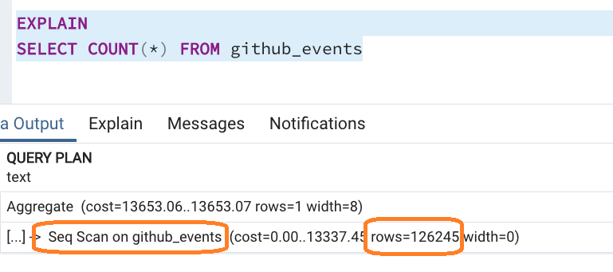
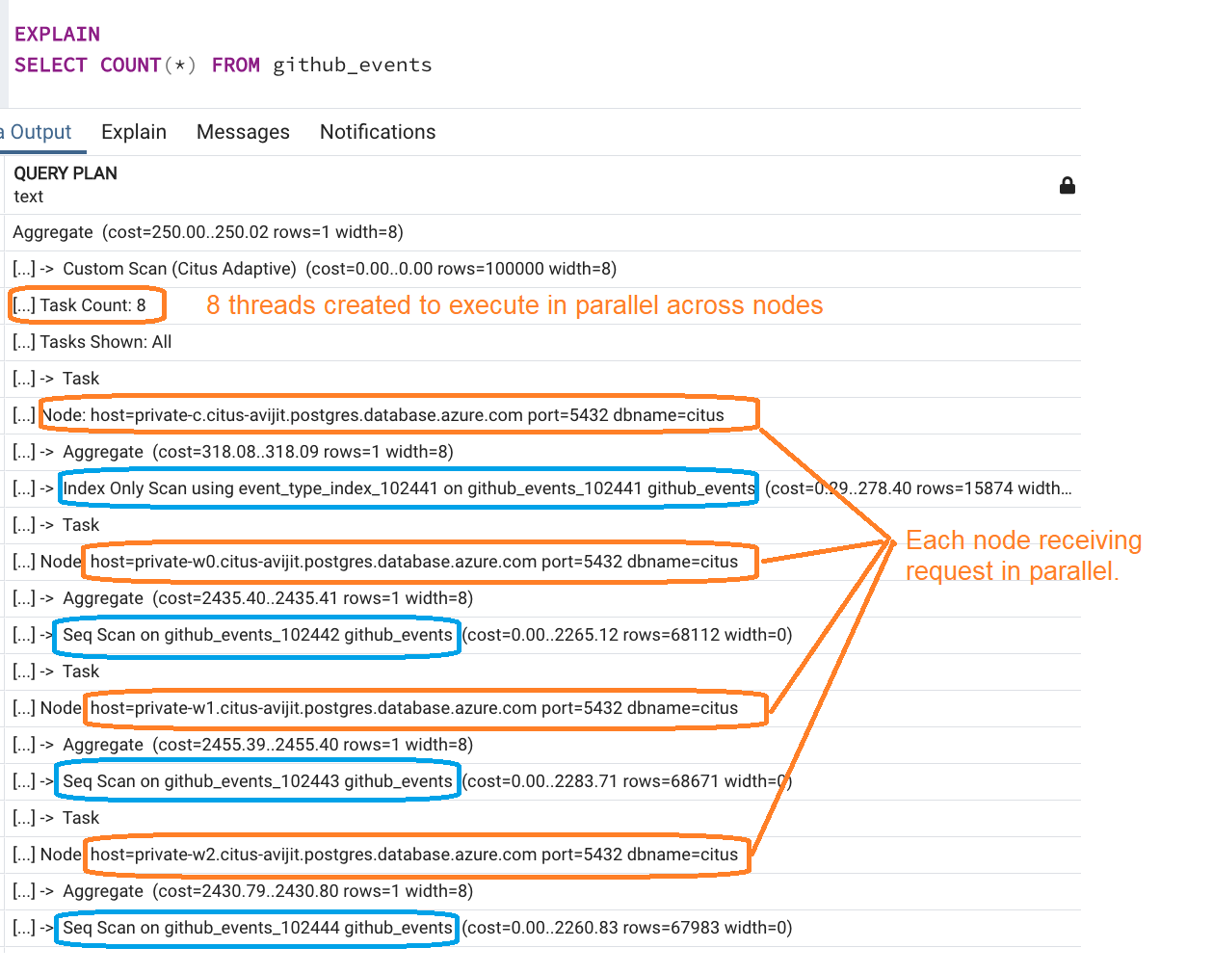
Query plan (Count(*))
Single node native Postgres
Azure Cosmos DB for Postgres (Multi-Node)

Slide 46
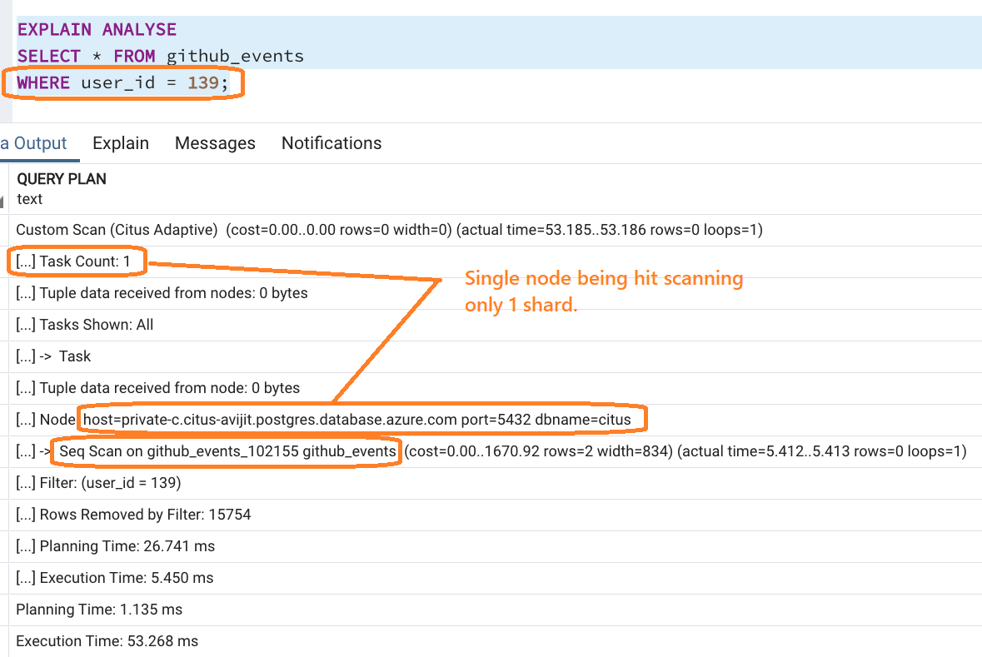
Query plan (Where)
Query with filter on shard key
Query without filter
Notes:
SET citus.explain_all_tasks = 1; -- allows to expand all tasks within execution plan
Some insights to interpretting the execution plan:
https://docs.citusdata.com/en/v11.0/develop/reference_processing.html

Slide 47
Query with Group By
WORKER NODES
W₁
SELECT company_id
sum(spend),
count(spend) …
FROM
campaigns_2001 …
Distributes queries across the cluster
APPLICATION
SELECT company_id
sum(spend),
count(spend) …
FROM
campaigns_2009 …
W₂
SELECT
FROM
GROUP BY
company_id,
avg(spend) AS avg_campaign_spend
campaigns
company_id;
METADATA
COORDINATOR NODE
SELECT company_id
sum(spend),
count(spend) …
FROM
campaigns_2017 …
W_{3 …} W_{n}
Notes:
Distribution of queries? Example average.
Query hits coordinator and coord sends sub queries to workers.
Workers compute and sends data back to coordinator which sends the result back to the application – increased performance

Slide 48
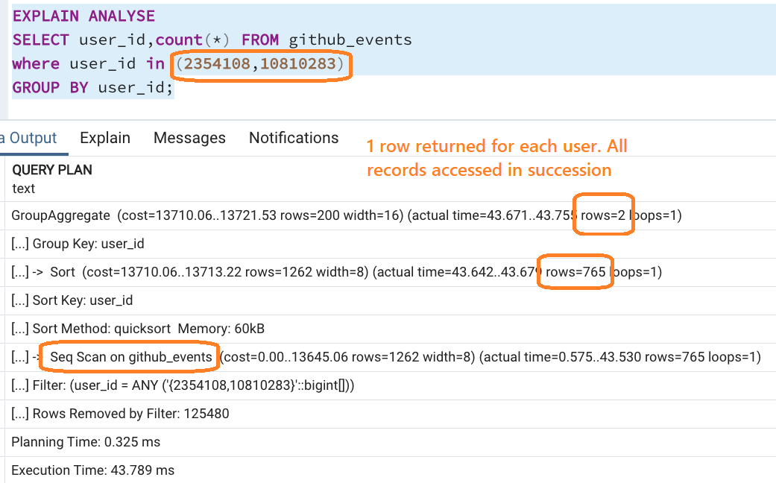
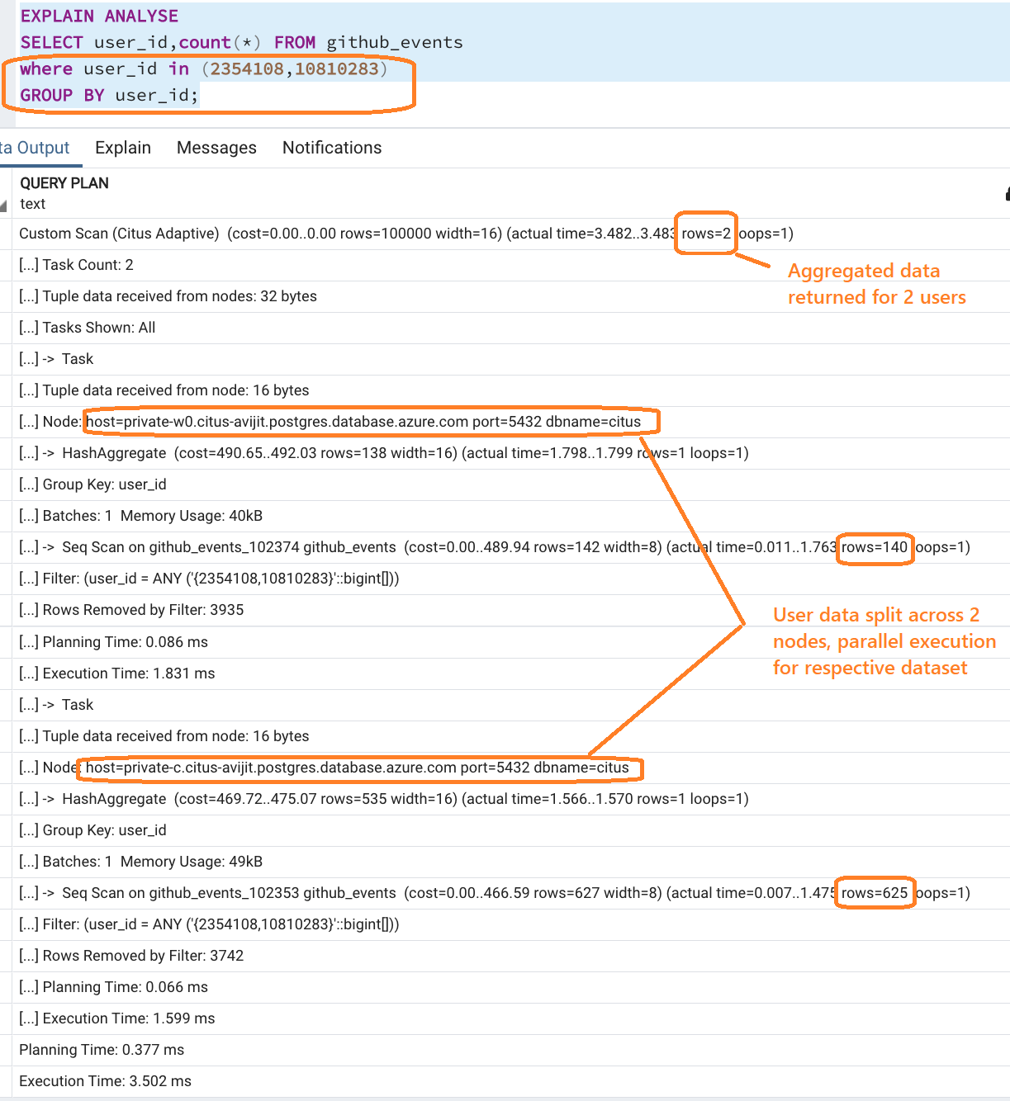
Query plan (Group By)
“Group By” on Single node Postgres
“Group By” on Azure Cosmos DB for Postgres
Notes:
Total Execution time shows 14x optimization for multi-node (cosmos db) setup

Slide 49
Parallelize execution with Group by

Slide 50
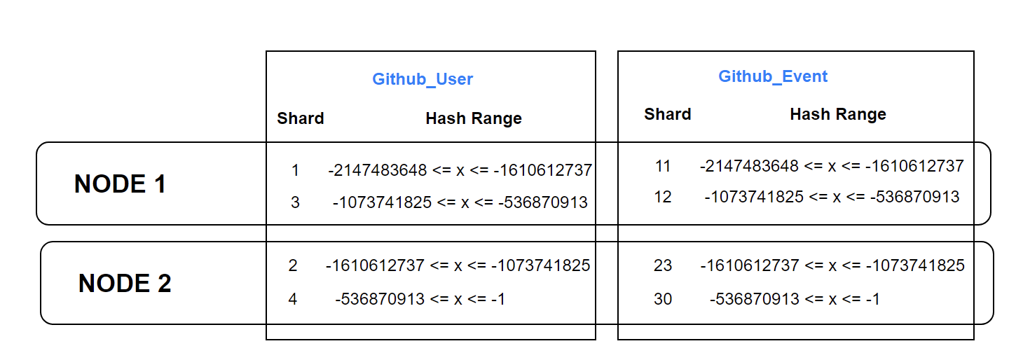
CO-LOCATION
Data distributed against common shard key are collocated on same shards

Slide 51
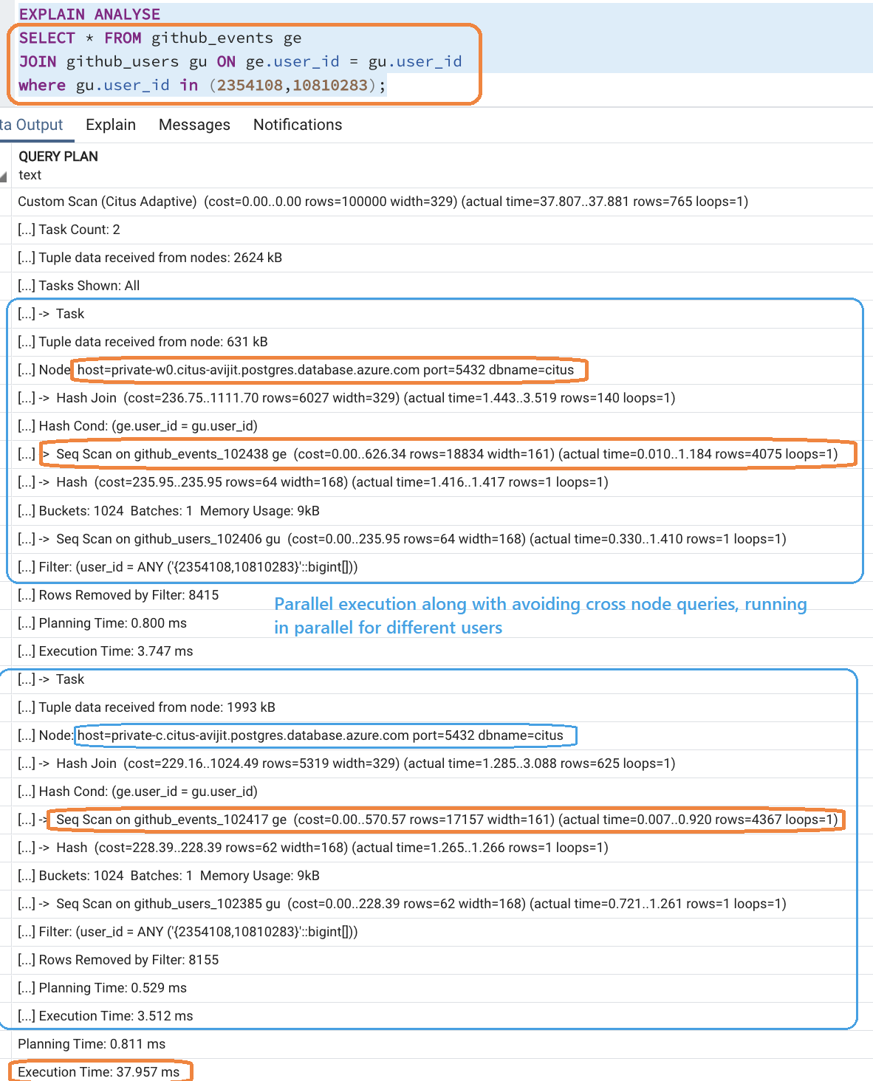
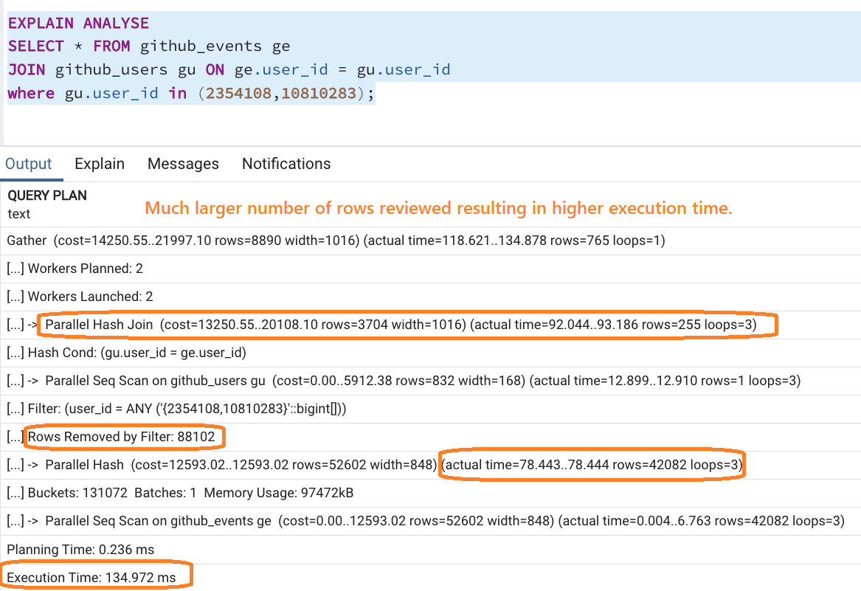
Query plan (JOIN)
Single node Postgres
Azure Cosmos DB for Postgres
Notes:
Some insights to interpretting the execution plan:
https://docs.citusdata.com/en/v11.0/develop/reference_processing.html

Slide 52
Scope JOIN within node
Notes:
Some insights to interpretting the execution plan:
https://docs.citusdata.com/en/v11.0/develop/reference_processing.html

Slide 53
Performance Tuning

Slide 54
Distributed Query Scoping
-- Missing filter on distribution column
-- Added filter on distribution column
UPDATE ads SET impressions_count = impressions_count+1
WHERE id = 42;
UPDATE ads SET impressions_count = impressions_count+1
WHERE id = 42 AND company_id = 1;
-- Missing distribution column in join
-- Added distribution column in join
SELECT page_id, count(event_id) FROM page
LEFT JOIN event USING (page_id)
WHERE tenant_id = 6 AND path LIKE '/blog%’
GROUP BY page_id;
SELECT page_id, count(event_id) FROM page
LEFT JOIN event USING (tenant_id, page_id)
WHERE tenant_id = 6 AND path LIKE '/blog%’
GROUP BY page_id;
-- logically correct, but slow
;WITH single_ad AS
( SELECT * FROM ads WHERE id=1 )
SELECT * FROM single_ad s
JOIN campaigns c ON (s.campaign_id=c.id);
-- faster, joining on distribution column
;WITH single_ad AS
( SELECT * FROM ads WHERE id=1 and company_id=1 )
SELECT * FROM single_ad s
JOIN campaigns c ON (s.campaign_id=c.id)
WHERE s.company_id=1 AND c.company_id = 1;
Notes:
Because of the tenantid filter and join on tenantid, Citus knows that the entire query can be answered using the set of co-located shards that contain the data for that particular tenant, and the PostgreSQL node can answer the query in a single step, which enables full SQL support.
Subquery/CTE Push-Pull Execution.

Slide 55
System health and locks
-- Equivalent of pg_stat_statement with additional detail on source node containing data
-- Applicable for Citus 11 and above
SELECT global_pid, nodeid, is_worker_query, query FROM citus_stat_activity
WHERE global_pid = 110000000123;
[ RECORD 1 ]---+----------------------------------------------------
global_pid | 110000000123
nodeid | 11
is_worker_query | f
query | UPDATE tbl SET b = 100 WHERE a = 0;
-- Update command here is blocking Delete
SELECT * FROM citus_lock_waits;
[ RECORD 1 ]-------------------------+-----------------------------
waiting_gpid | 20000000345
blocking_gpid | 110000000123
blocked_statement | DELETE FROM tbl WHERE a = 0;
current_statement_in_blocking_process | UPDATE tbl SET b = 100 WHERE a = 0;
waiting_nodeid | 2
blocking_nodeid | 11

Slide 56
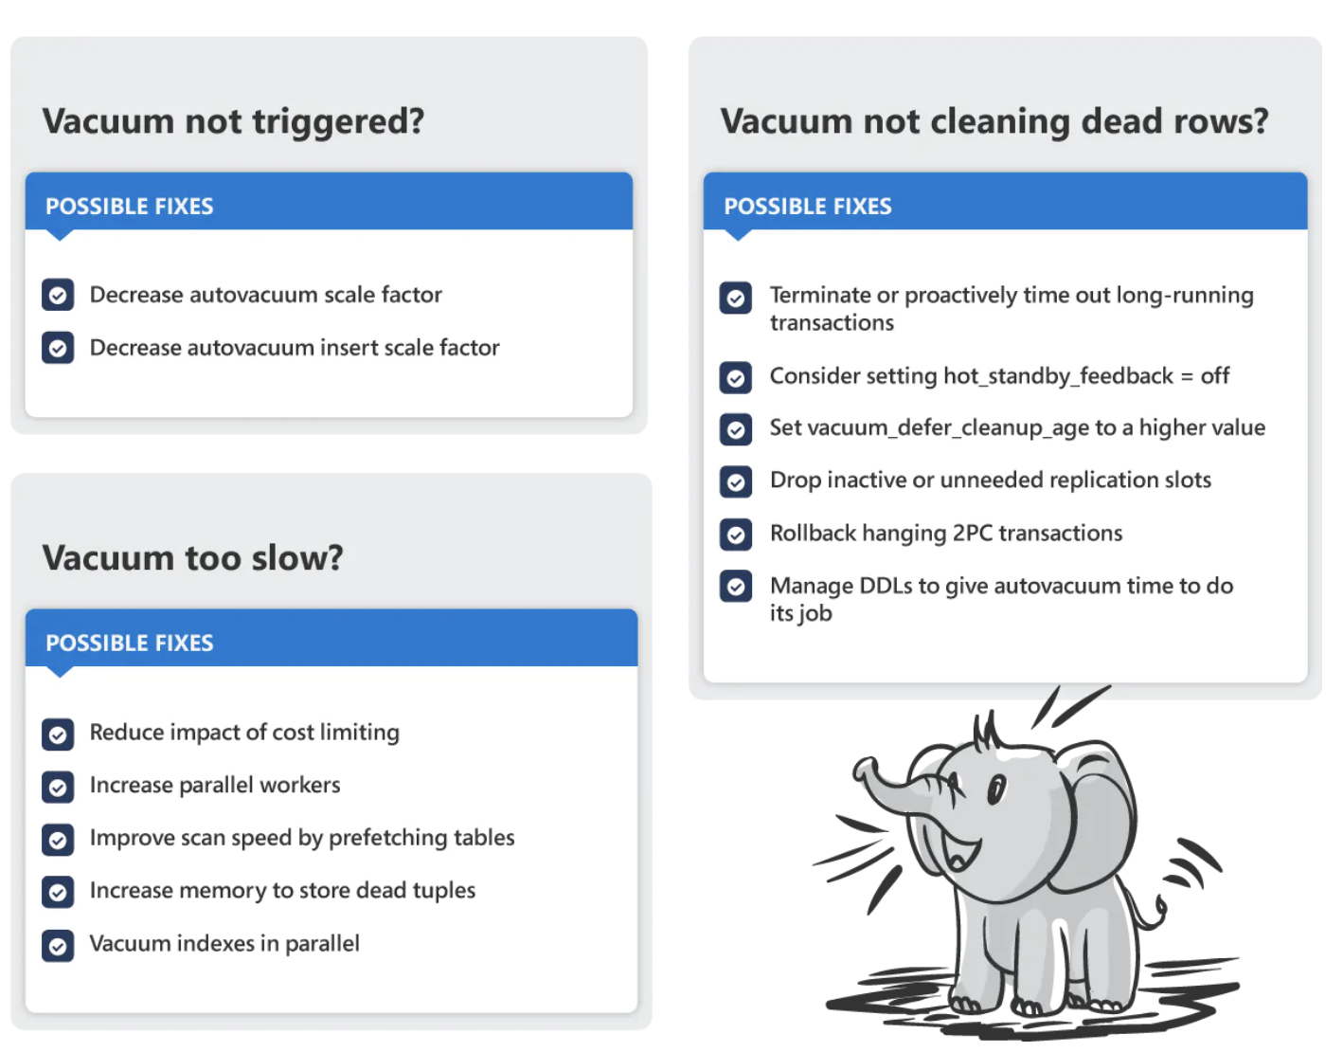
Vacuuming
Vacuum not triggered enough
autovacuum_vacuum_scale_factor | Lower the value to trigger vacuuming more frequently, useful for larger tables with more updates / deletes.
autovacuum_vacuum_insert_scale_factor | Lower the values to trigger vacuuming more frequently for large, insert-heavy tables.
Vacuum too slow
autovacuum_vacuum_cost_delay | Decrease to reduce cost limiting sleep time and make vacuuming faster.
autovacuum_vacuum_cost_limit | Increase the cost to be accumulated before vacuum will sleep, thereby reducing sleep frequency and making vacuum go faster.
autovacuum_max_workers | Increase to allow more parallel workers to be triggered by autovacuum.
max_parallel_maintenance_workers | Increase to allow `VACUUM` to vacuum more indexes in parallel.*
Vacuum isn’t cleaning up dead rows
statement_timeout | Set to automatically terminate long-running queries after a specified time.**
log_min_duration_statement | Set to log each completed statement which takes longer than the specified timeout.**
hot_standby_feedback | Set to “on” so the standby sends feedback to the primary about running queries. Decreases query cancellation, but can increase bloat. Consider switching “off” if bloat is too high.
Notes:
https://www.citusdata.com/blog/2022/07/28/debugging-postgres-autovacuum-problems-13-tips/

Slide 57
Judicial Logging
Database logging is an important part of your highly available database solution, though it is important to understand that it often become an overhead without judicial log levels.
setting | value | reason
log_statement_stats | OFF | Avoid profiling overhead
log_duration | OFF | Don't need to know the duration of normal queries
log_statement | NONE | Don't log queries without specific reason
log_min_duration_statement | A value longer than what you think normal queries should take | Shows the abnormally long queries
Notes:
https://www.citusdata.com/blog/2022/03/12/how-to-benchmark-performance-of-citus-and-postgres-with-hammerdb/

Slide 58
Additional Tips
PostgreSQL supports building indices concurrently, to avoid taking a write lock on the table.
Consider setting lock_timeout in a SQL session prior to running a heavy DDL command. With lock_timeout, PostgreSQL will abort the DDL command if the command waits too long for a write lock. A DDL command waiting for a lock can cause later queries to queue behind itself.
Client Side connection pooling : A connection pool holds open database connections for reuse. An application requests a connection from the pool when needed, and the pool returns one that is already established if possible, or establishes a new one. When done, the application releases the connection back to the pool rather than closing it.
Adding a client-side connection pool is an easy way to boost application performance with minimal code
changes. In our measurements, running single-row insert statements goes about 24x faster on a Hyperscale
(Citus) server group with pooling enabled.

Slide 59
Management

Slide 60
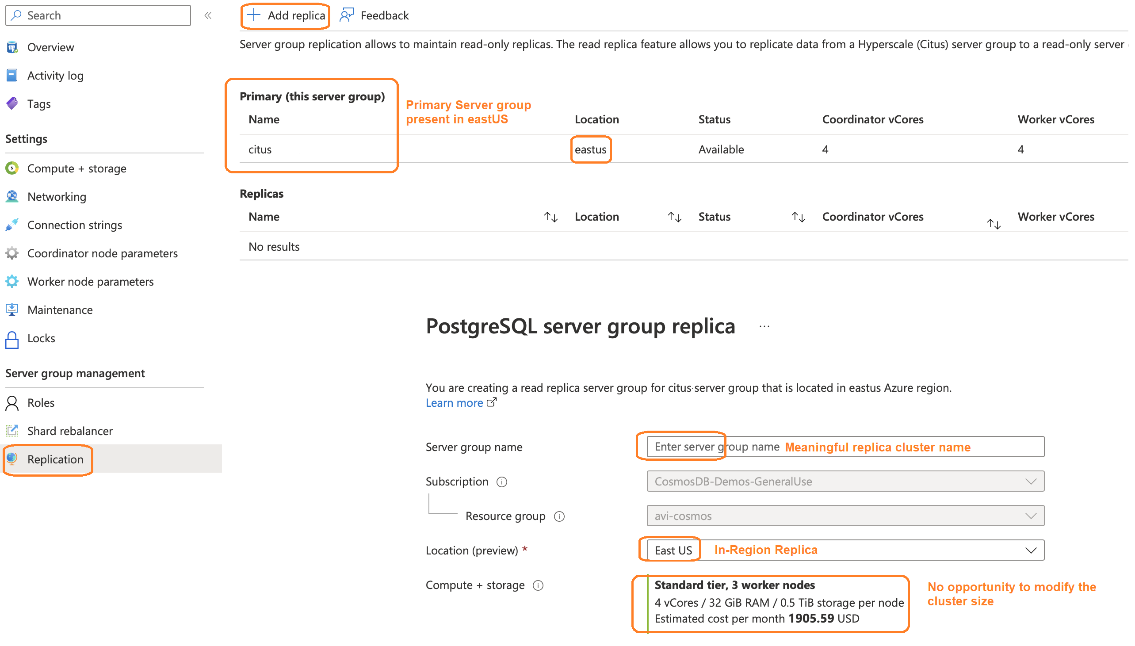
Replica Creation
Notes:
Queries from customer :
Asynchronous
Replica promotion – Naming correction after promotion.

Slide 61
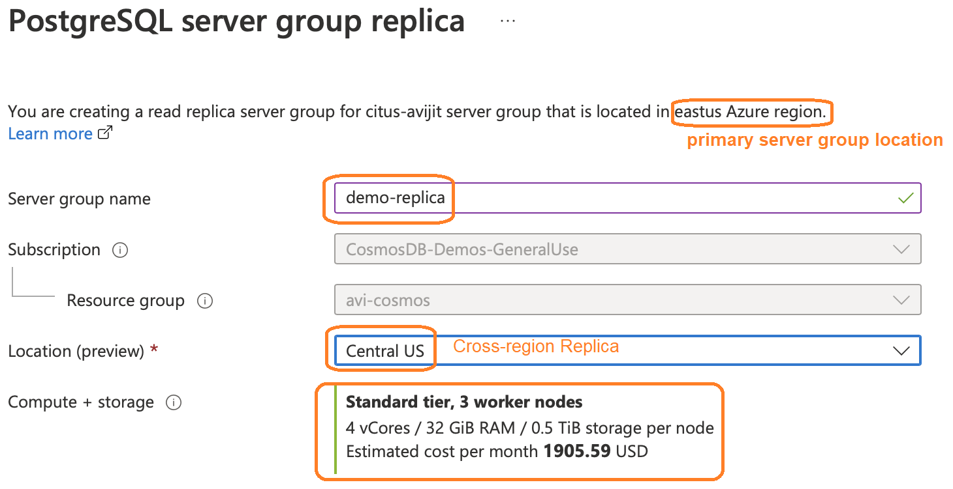
Replica Creation (Cross region)
Notes:
SPLIT into 2 slides with In-Region and Cross region provisioning

Slide 62
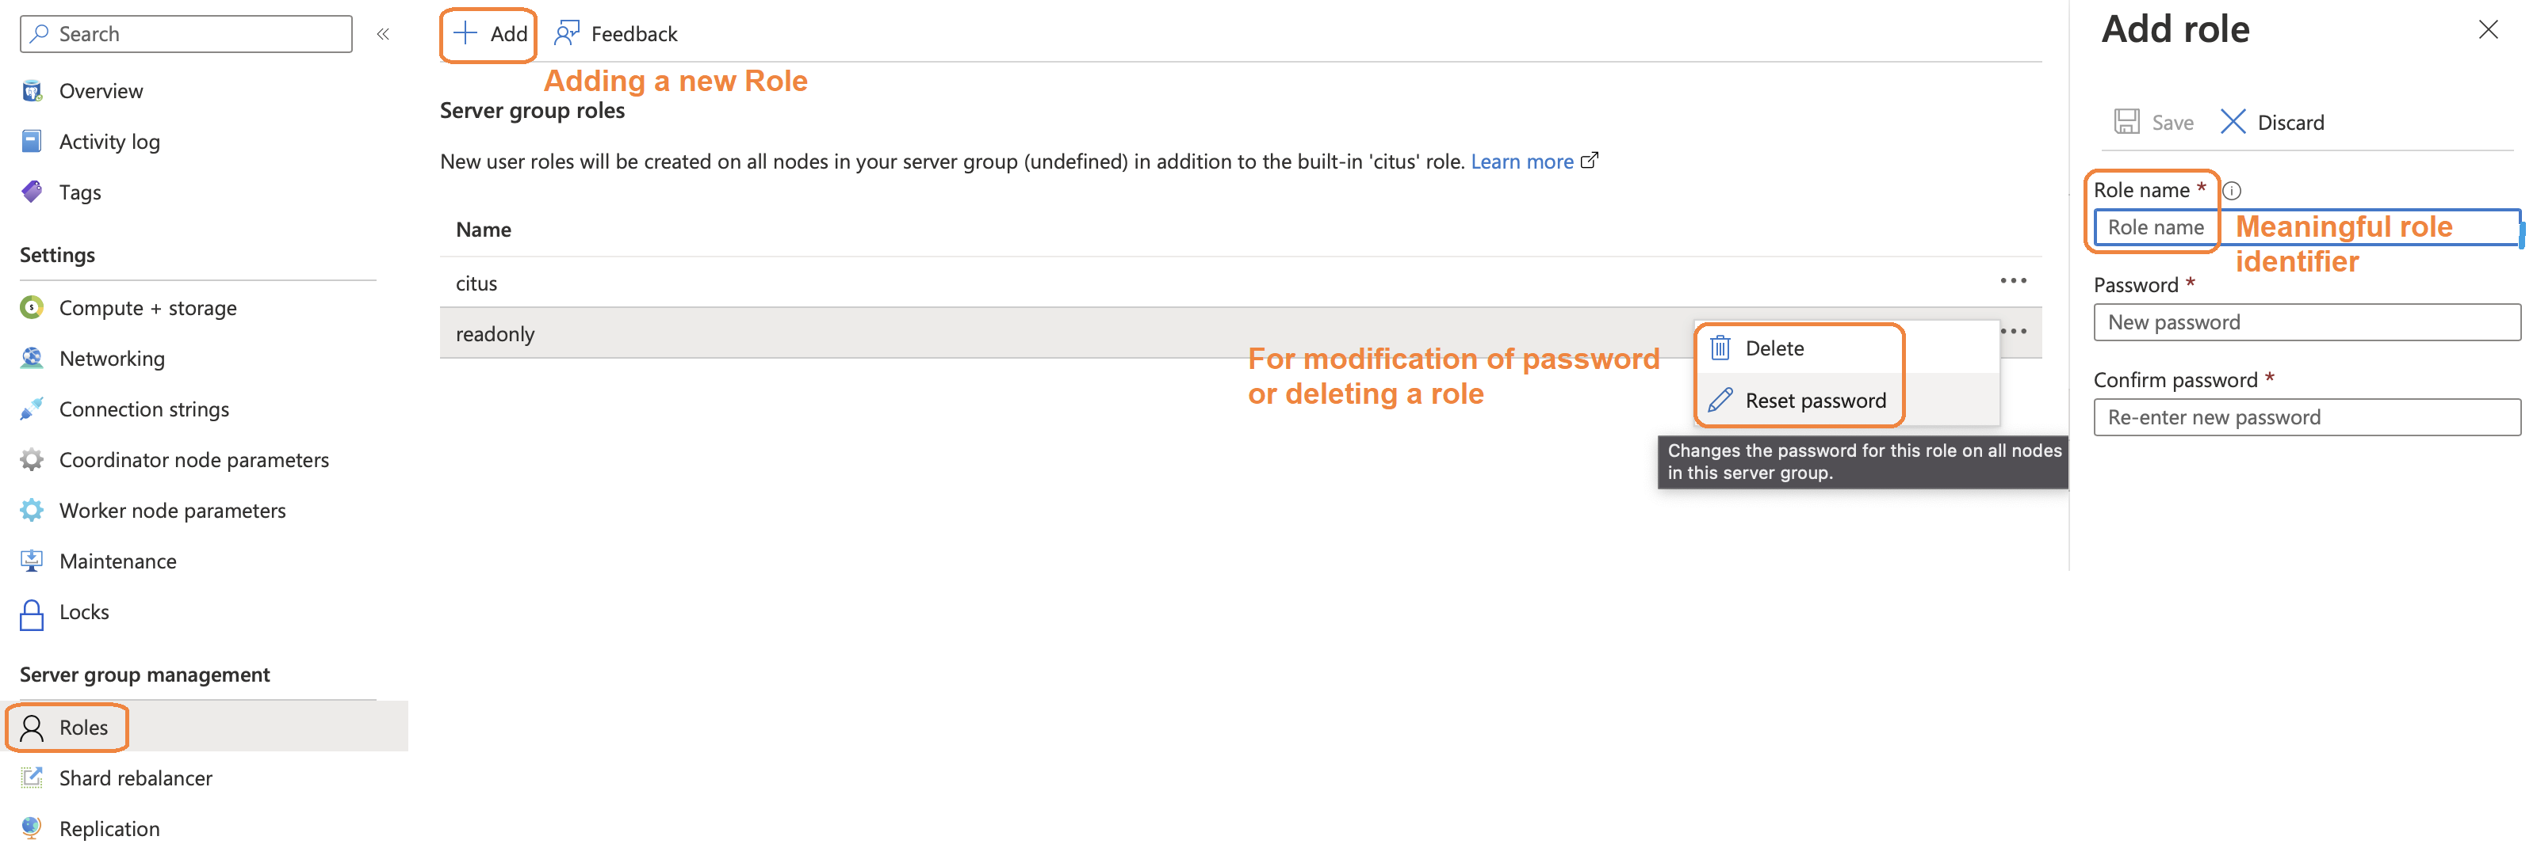
Role Creation

Slide 63
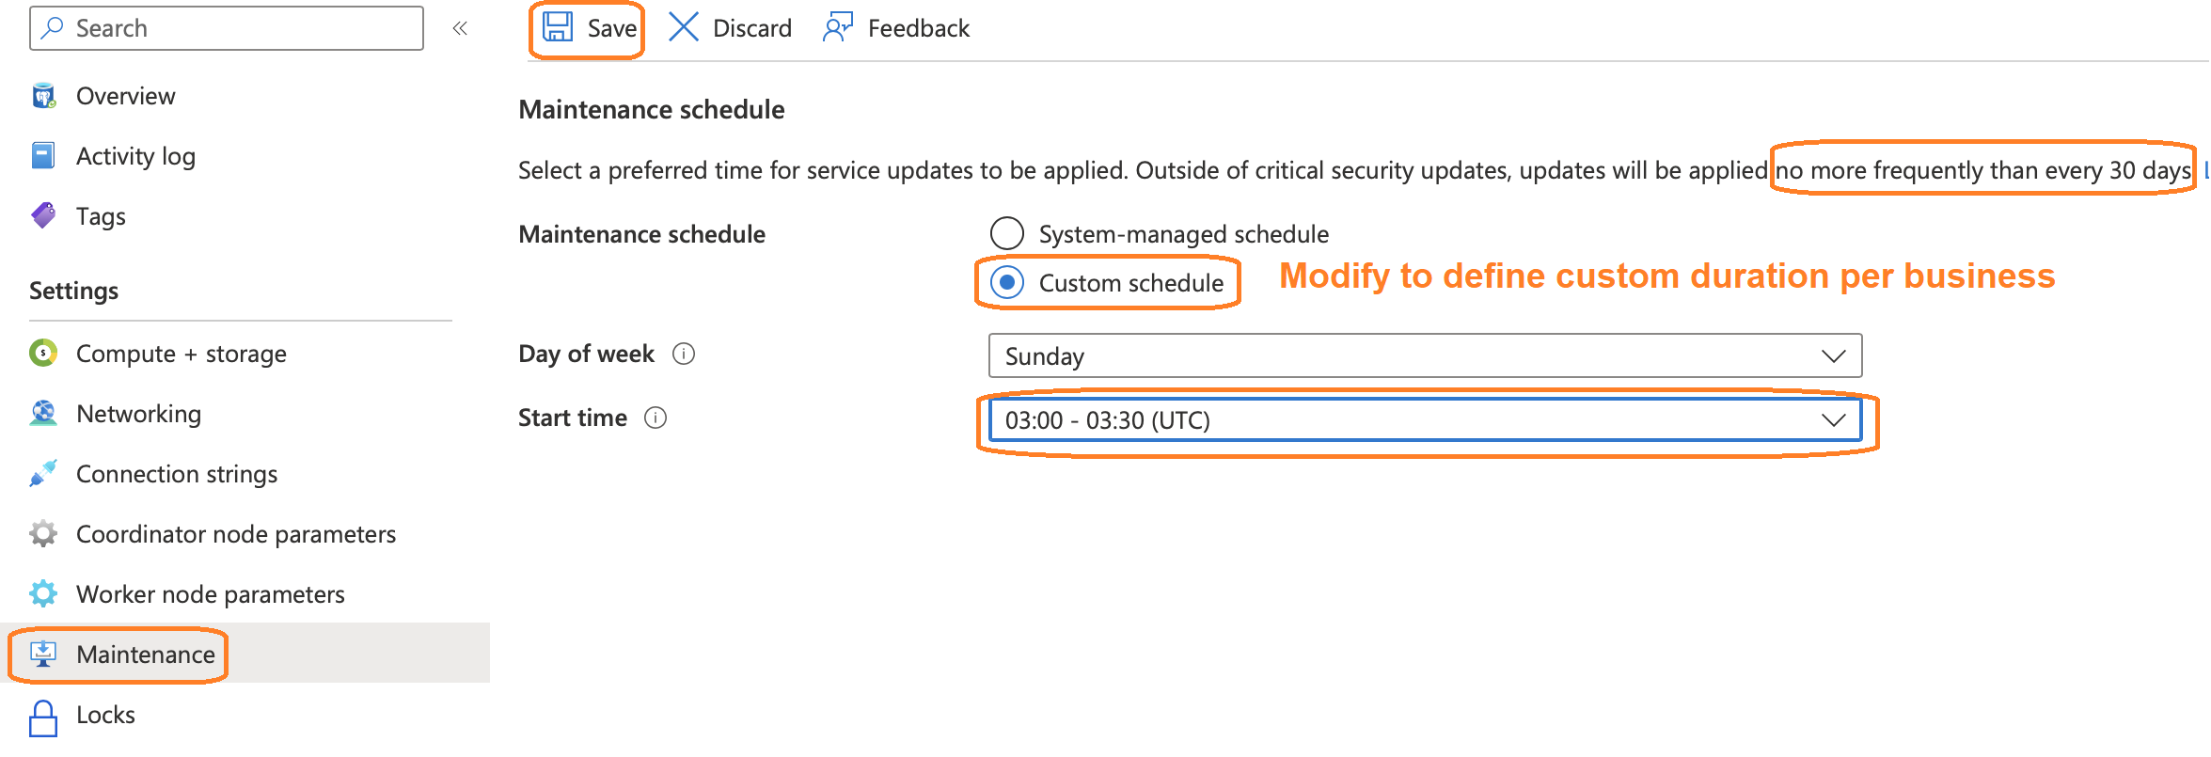
Maintenance Schedule

Slide 64
Backup & Restore
Continuous backups
Worker 1
Worker 2
Long term log storage
Worker 3
Start LSN of oldest transaction among all snapshots
Point in time
Point in time
Primary Compute
Recovery
Backup has no impact to apps
Parallelized copy (metadata)
Constant time PITR
Restore
Long term long storage
Azure Managed Disk
Azure Managed Disk
Azure Managed Disk

Slide 65
Cluster Management
Finding which shard contains data for a specific tenant
SELECT shardid, shardstate, shardlength, nodename, nodeport, placementid
FROM pg_dist_placement AS placement, pg_dist_node AS node
WHERE placement.groupid = node.groupid AND node.noderole = 'primary’
AND shardid = ( SELECT get_shard_id_for_distribution_column('stores', 4) );
Identify the size of shards
SELECT shardid, table_name, shard_size FROM citus_shards WHERE table_name = 'my_table';
Review execution plan for Rebalance strategy
SELECT get_rebalance_table_shards_plan( rebalance_strategy := 'by_disk_size’ );
Monitor the progress of every shard being planned for move
SELECT * FROM get_rebalance_progress();
Notes:
Draining a node isn’t exposed directly to users, though it is possible to achieve by logging a ticket with background support team. Need not be shared with customers as such.
Run this for each node that you want to remove:
SELECT * FROM citus_set_node_property(node_hostname, node_port, 'shouldhaveshards', false);
2.Drain them all at once with rebalance_table_shards:
SELECT * FROM rebalance_table_shards(drain_only := true);
3.Wait until the draining rebalance finishe
4.Remove the nodes

Slide 66
Database Management Part 1
Identify, distributed & reference tables with corresponding sharding key & number of shards
SELECT table_name::text, citus_table_type, distribution_column, shard_count
FROM citus_tables;
Identify tables collocated & their size in Kbs
SELECT c.colocation_id,table_name, table_size FROM pg_dist_colocation p
JOIN citus_tables c ON p.colocationid = c.colocation_id
WHERE c.colocation_id = 42;
Lists queries with the number of executions & partition_key
SELECT * FROM citus_stat_statements;
Review the nodes and properties like has_meta_data, should_have_shards, node role etc.
SELECT * FROM pg_dist_node;

Slide 67
Database Management Part 2
Identify unused indexes
SELECT * FROM run_command_on_shards('my_distributed_table', $cmd$ SELECT array_agg(a) as infos FROM ( SELECT ( schemaname || '.' || relname || '##' || indexrelname || '##' || pg_size_pretty(pg_relation_size(i.indexrelid))::text || '##' || idx_scan::text ) AS a
FROM pg_stat_user_indexes ui
JOIN pg_index i ON ui.indexrelid = i.indexrelid
WHERE NOT indisunique AND idx_scan < 50 AND pg_relation_size(relid) > 5 * 8192
AND (schemaname || '.' || relname)::regclass = '%s'::regclass ORDER BY pg_relation_size(i.indexrelid) / NULLIF(idx_scan, 0) DESC nulls first, pg_relation_size(i.indexrelid) DESC ) sub $cmd$);
Index Hit Rate
-- on coordinator
SELECT 100 * (sum(idx_blks_hit) - sum(idx_blks_read)) / sum(idx_blks_hit) AS index_hit_rate
FROM pg_statio_user_indexes;
-- on workers
SELECT nodename, result as index_hit_rate
FROM run_command_on_workers($cmd$ SELECT 100 * (sum(idx_blks_hit) - sum(idx_blks_read)) / sum(idx_blks_hit) AS index_hit_rate FROM pg_statio_user_indexes; $cmd$);

Slide 68
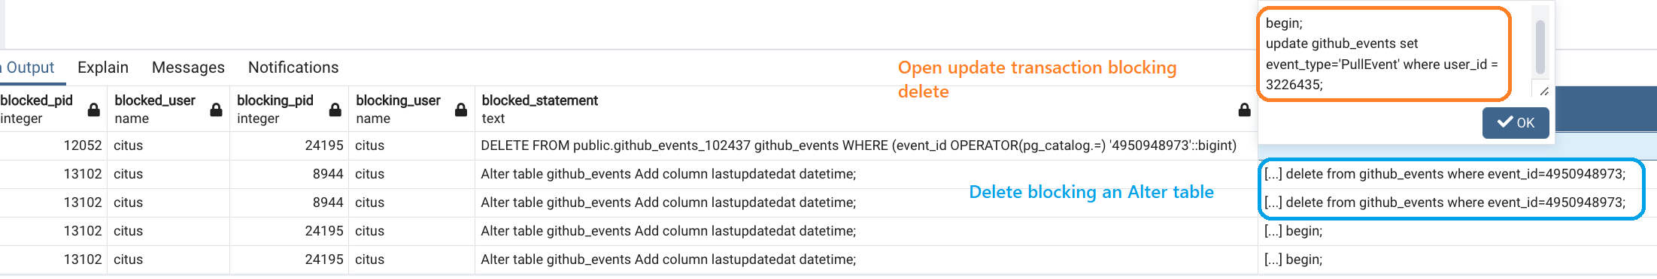
Database Management Part 3
Viewing active queries running
SELECT global_pid, query, state FROM citus_stat_activity WHERE state != 'idle';
Why are the queries waiting
SELECT wait_event || ':' || wait_event_type AS type, count(*) AS number_of_occurences
FROM pg_stat_activity WHERE state != 'idle’
GROUP BY wait_event, wait_event_type ORDER BY number_of_occurences DESC;
Blocking chains could be reviewed using queries covered under Lock_Monitoring
Notes:
Pg_stat_activity : It shows session on local node
Citus_stat_activity : shows global pg_stat_activity
Citus_dist_stat_activity : shows all queries performed by client
Additional links to learn more on debugging locking :
https://www.citusdata.com/blog/2018/02/22/seven-tips-for-dealing-with-postgres-locks/
https://pganalyze.com/blog/postgresql-log-monitoring-101-deadlocks-checkpoints-blocked-queries
https://wiki.postgresql.org/wiki/Lock_Monitoring

Slide 69
Infrastructure Management
Query to review roles & associated privileges
SELECT grantee,grantor,table_name,ARRAY_AGG(privilege_type)
FROM information_schema.role_table_grants
WHERE grantee IN ('citus','readonly','avijit') and "table_name" IN ('github_events')
GROUP BY grantee,grantor,table_name
Validate for last back up & duration for it
AzureDiagnostics
| order by TimeGenerated desc
| where LogicalServerName_s == ”demo-all-tests-c"
| where TimeGenerated > ago(7d)
| where Message contains ”back up started” OR Message contains ”back up completed”
Validate for last maintenance & any downtime involved
AzureDiagnostics
| order by TimeGenerated desc
| where LogicalServerName_s == ”demo-all-tests-c"
| where TimeGenerated > ago(30d)
| where Message contains ”Maintenance started” AND Message contains ”connection failed”

Slide 70
Monitoring

Slide 71
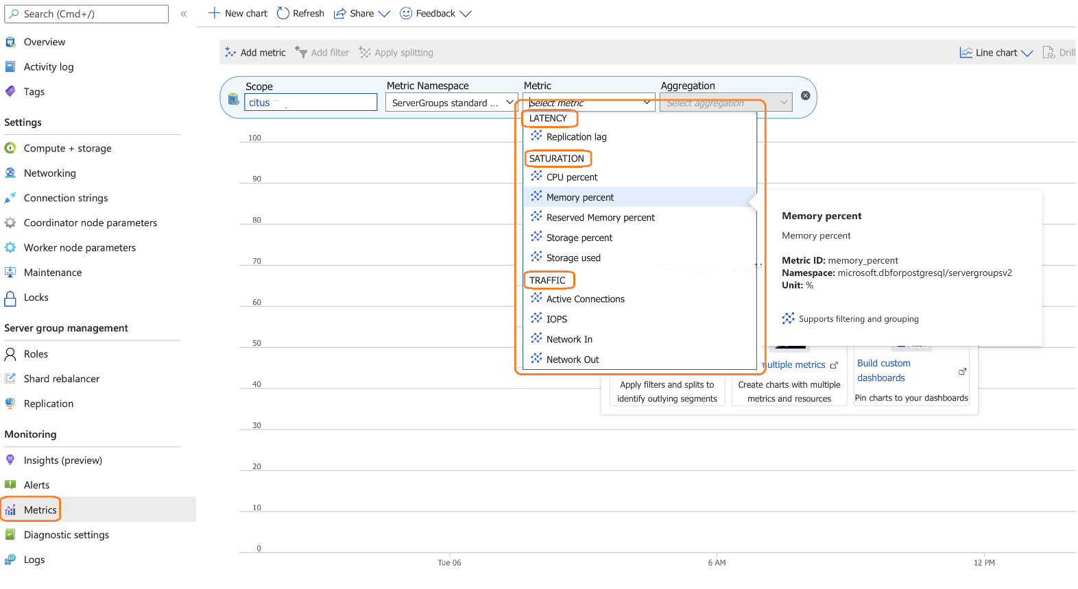
Dashboard Metrics

Slide 72
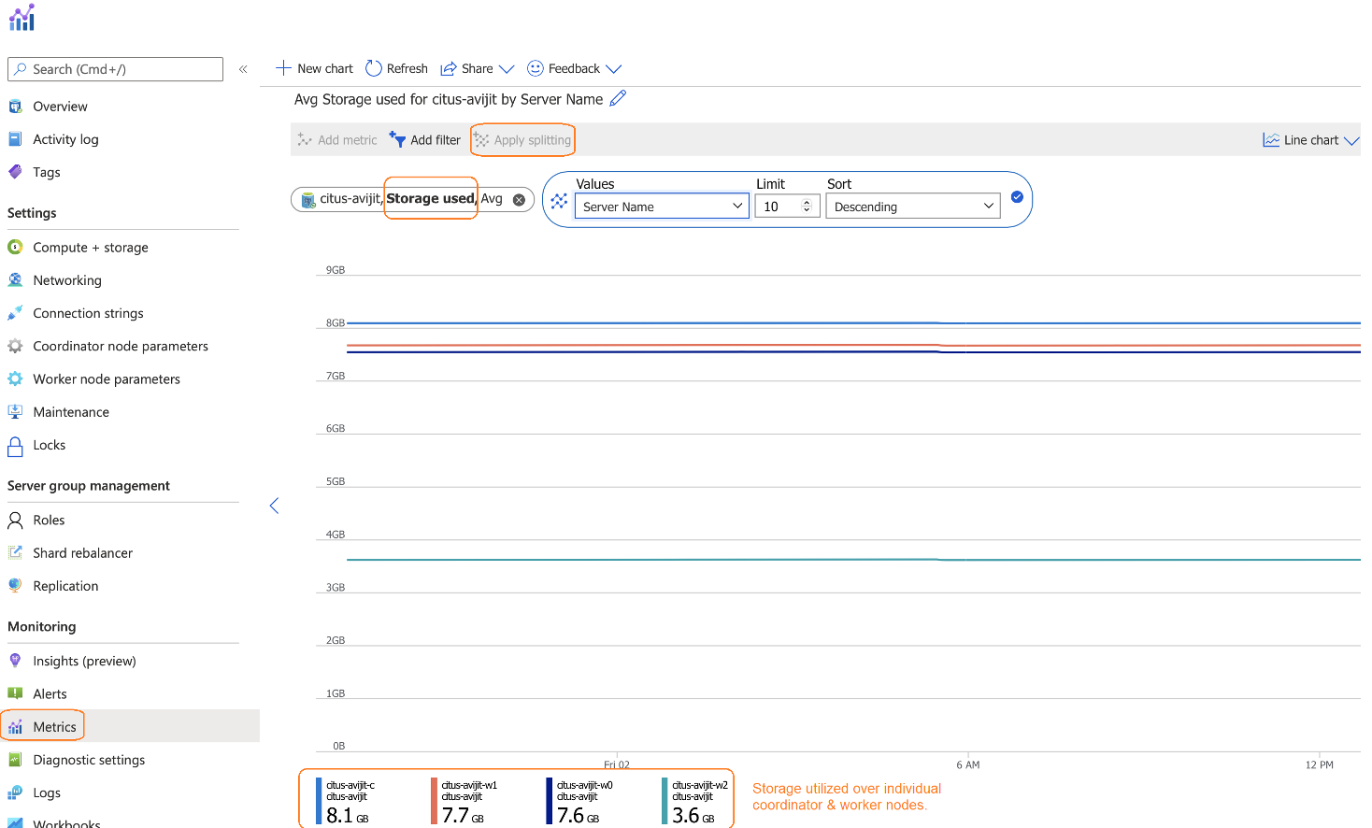
Dashboard Metrics
Notes:
Choose the metric on previous page, followed by “APPLY SPLITTING” & choosing the Server Name from drop down. This allows view of metrics segregated across multiple nodes in cluster.

Slide 73
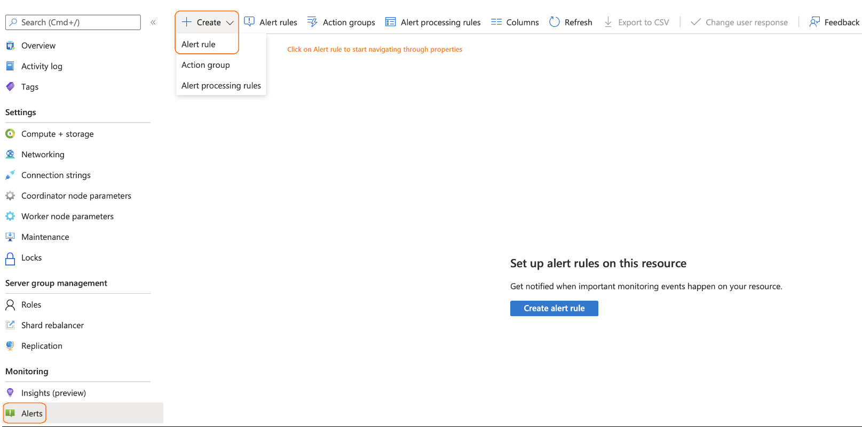
Create Alert

Slide 74
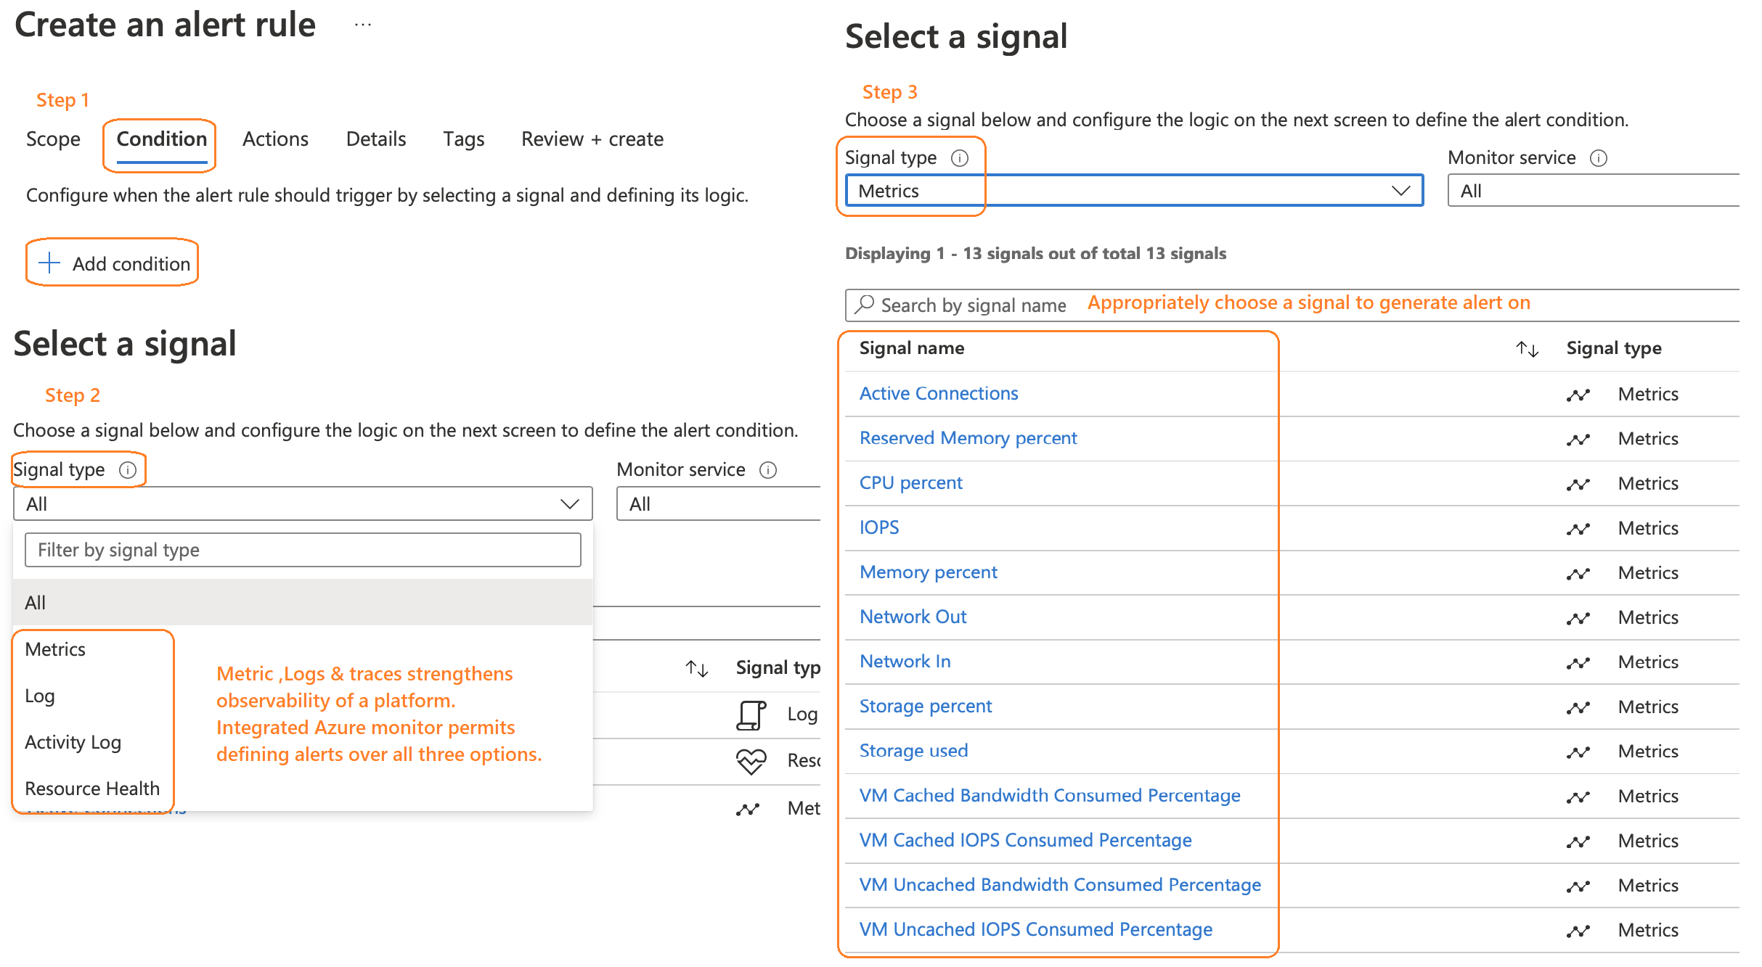
Define Alert Metric

Slide 75
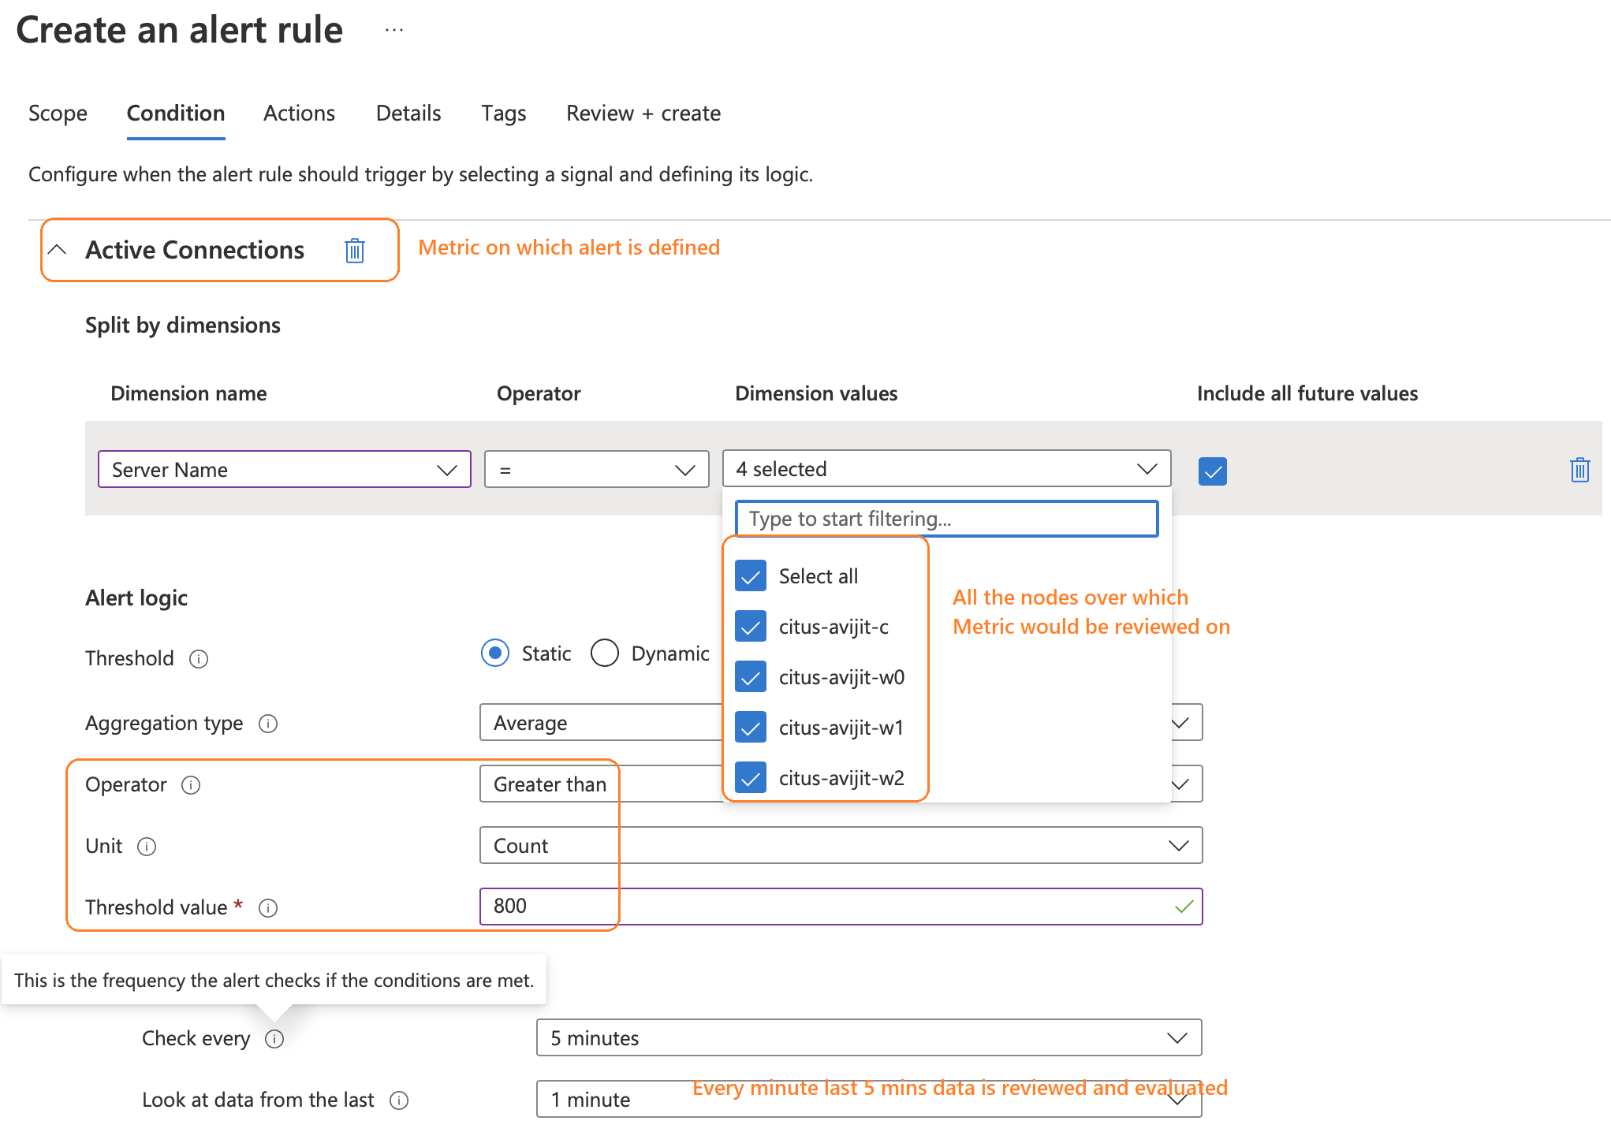
Define Alert Logic

Slide 76
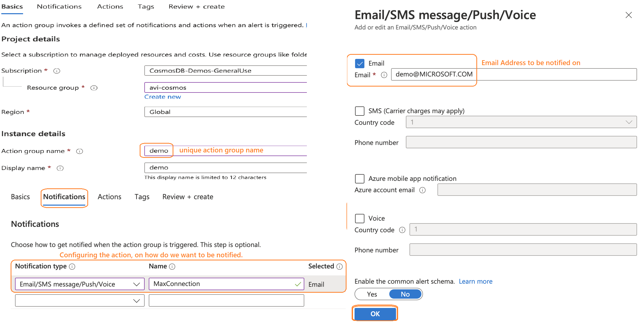
Define action group identifiers

Slide 77
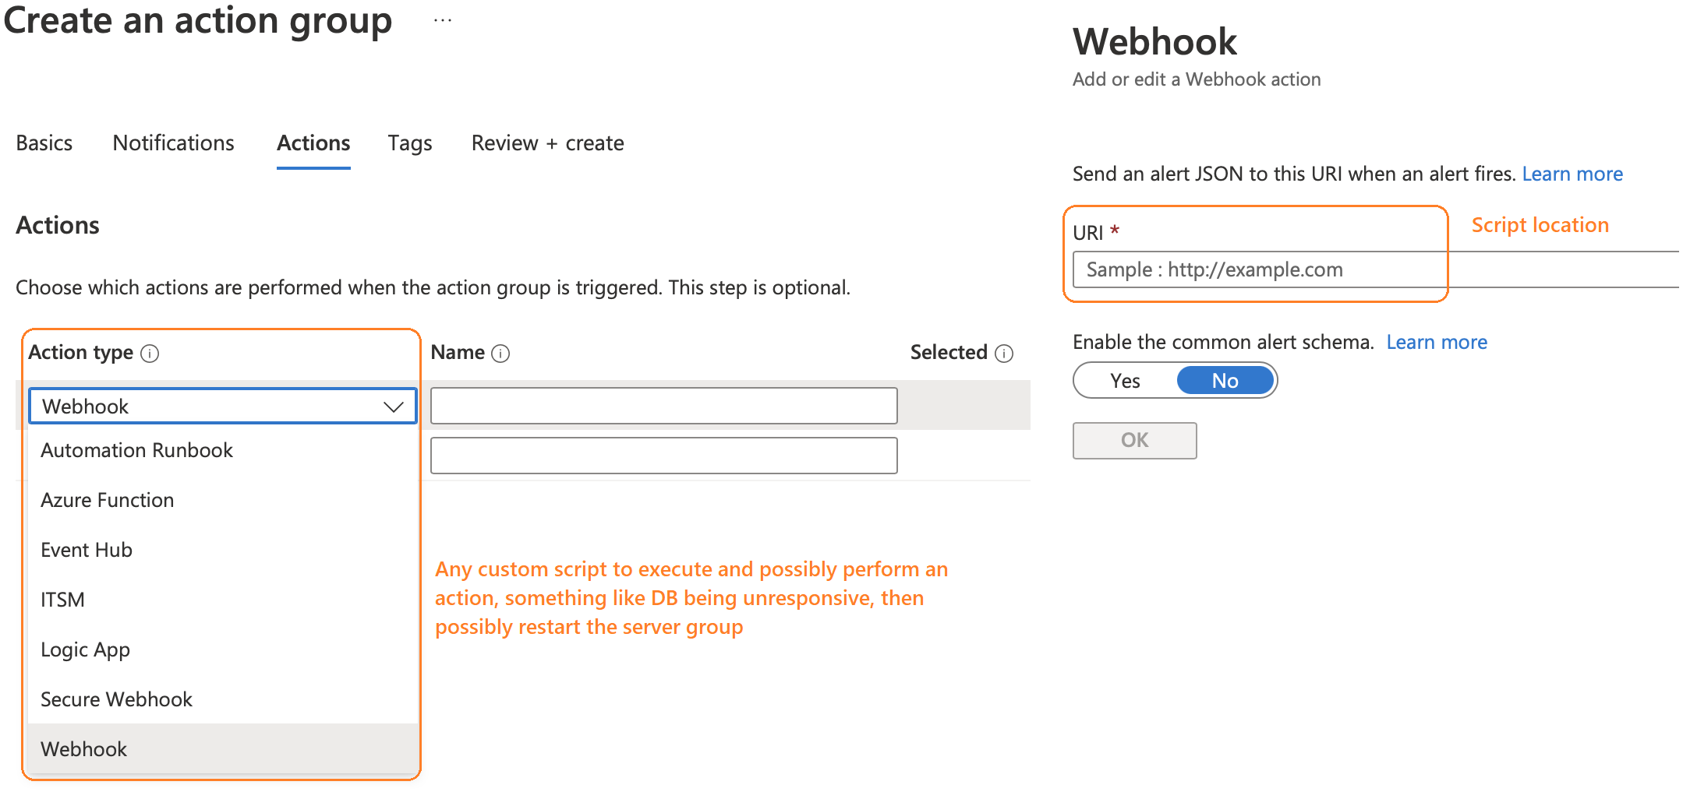
Define additional custom actions
Notes:
Add What and Why and some background on what does action type do…

Slide 78
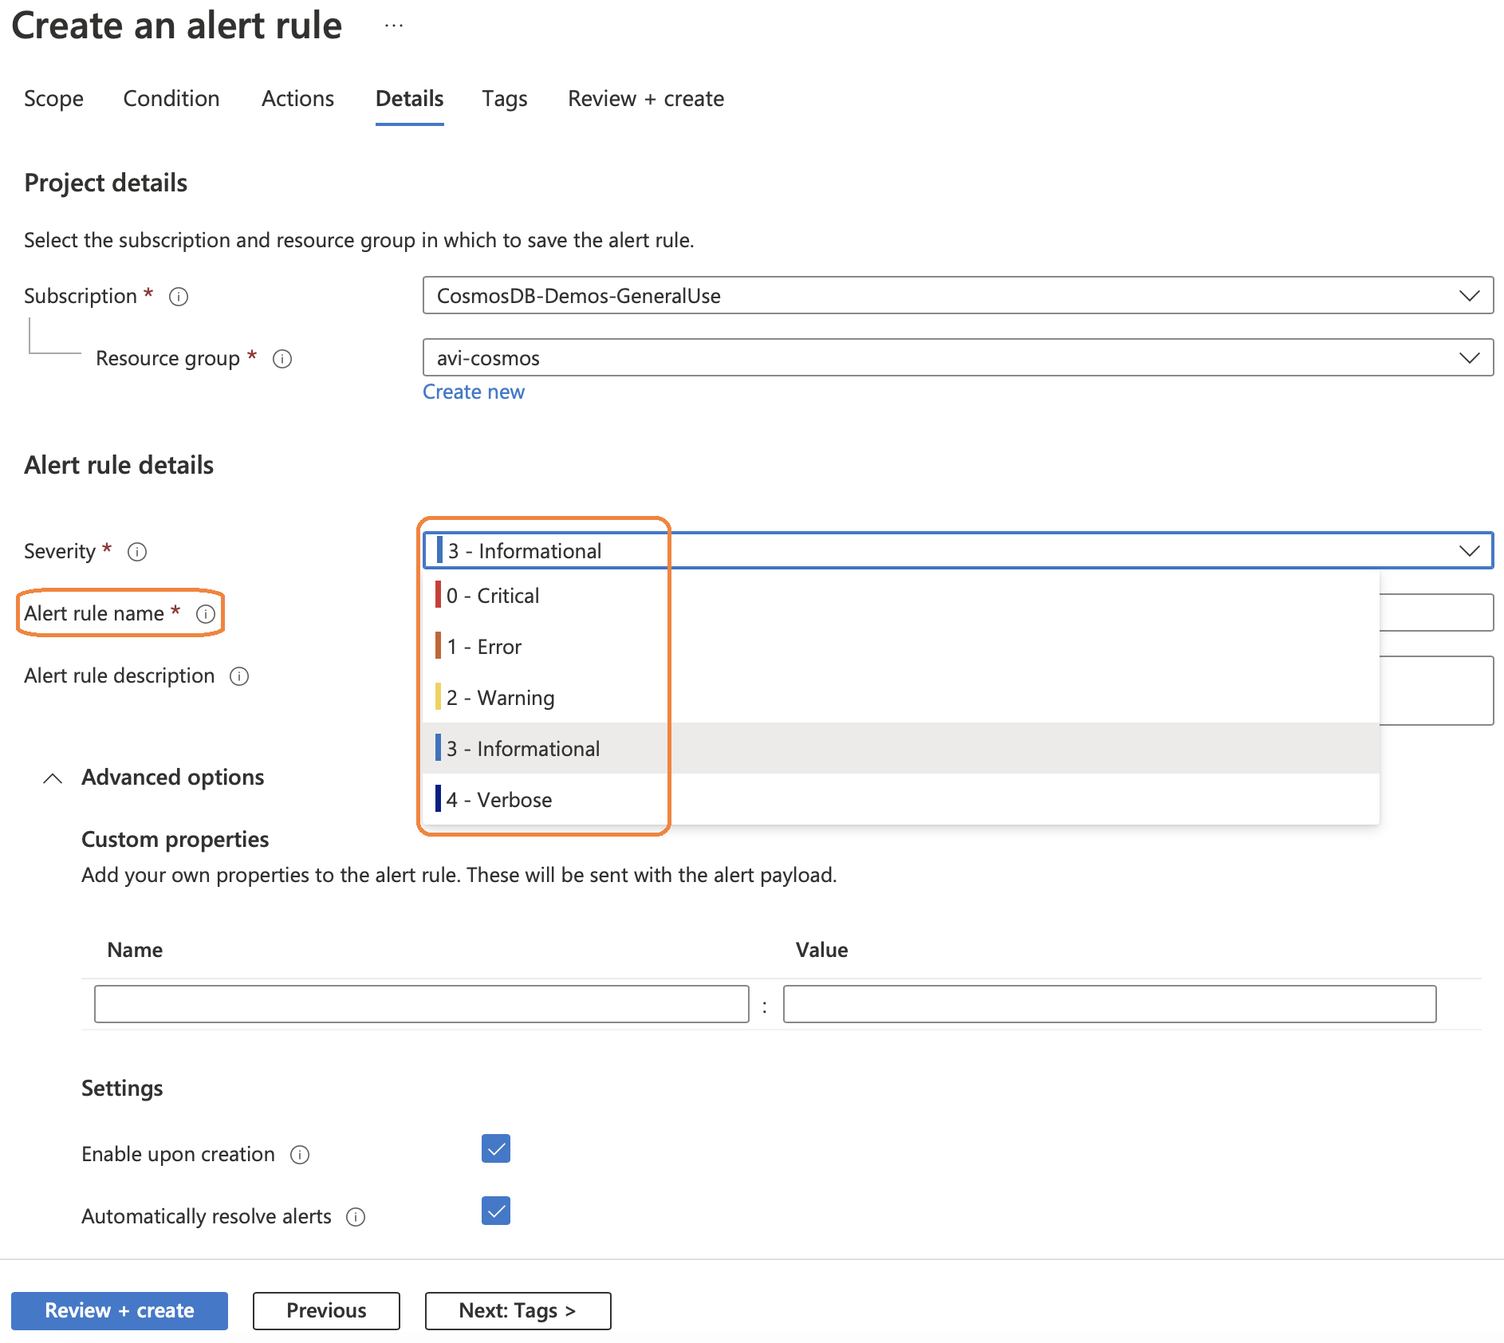
Define severity for rule

Slide 79
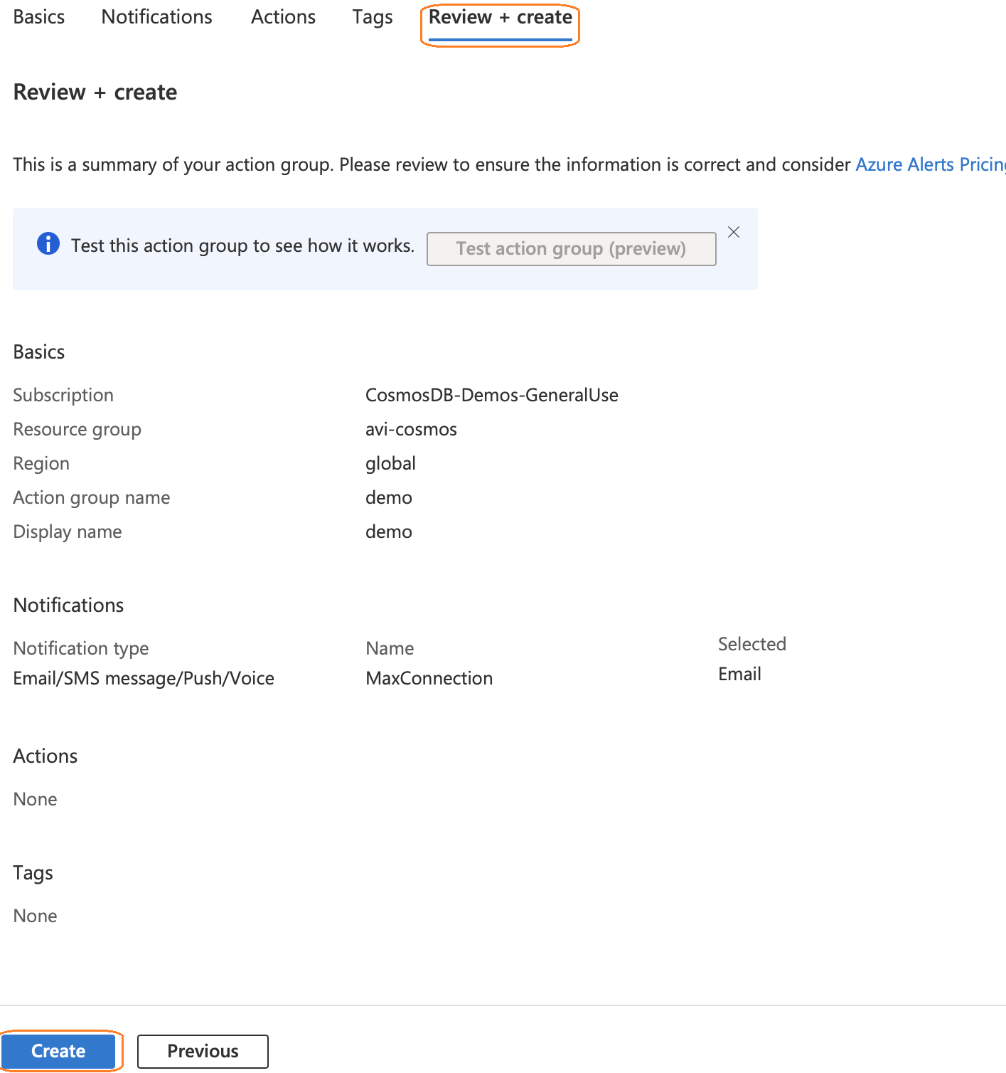
Review & Create action group

Slide 80
Log Analytics

Slide 81
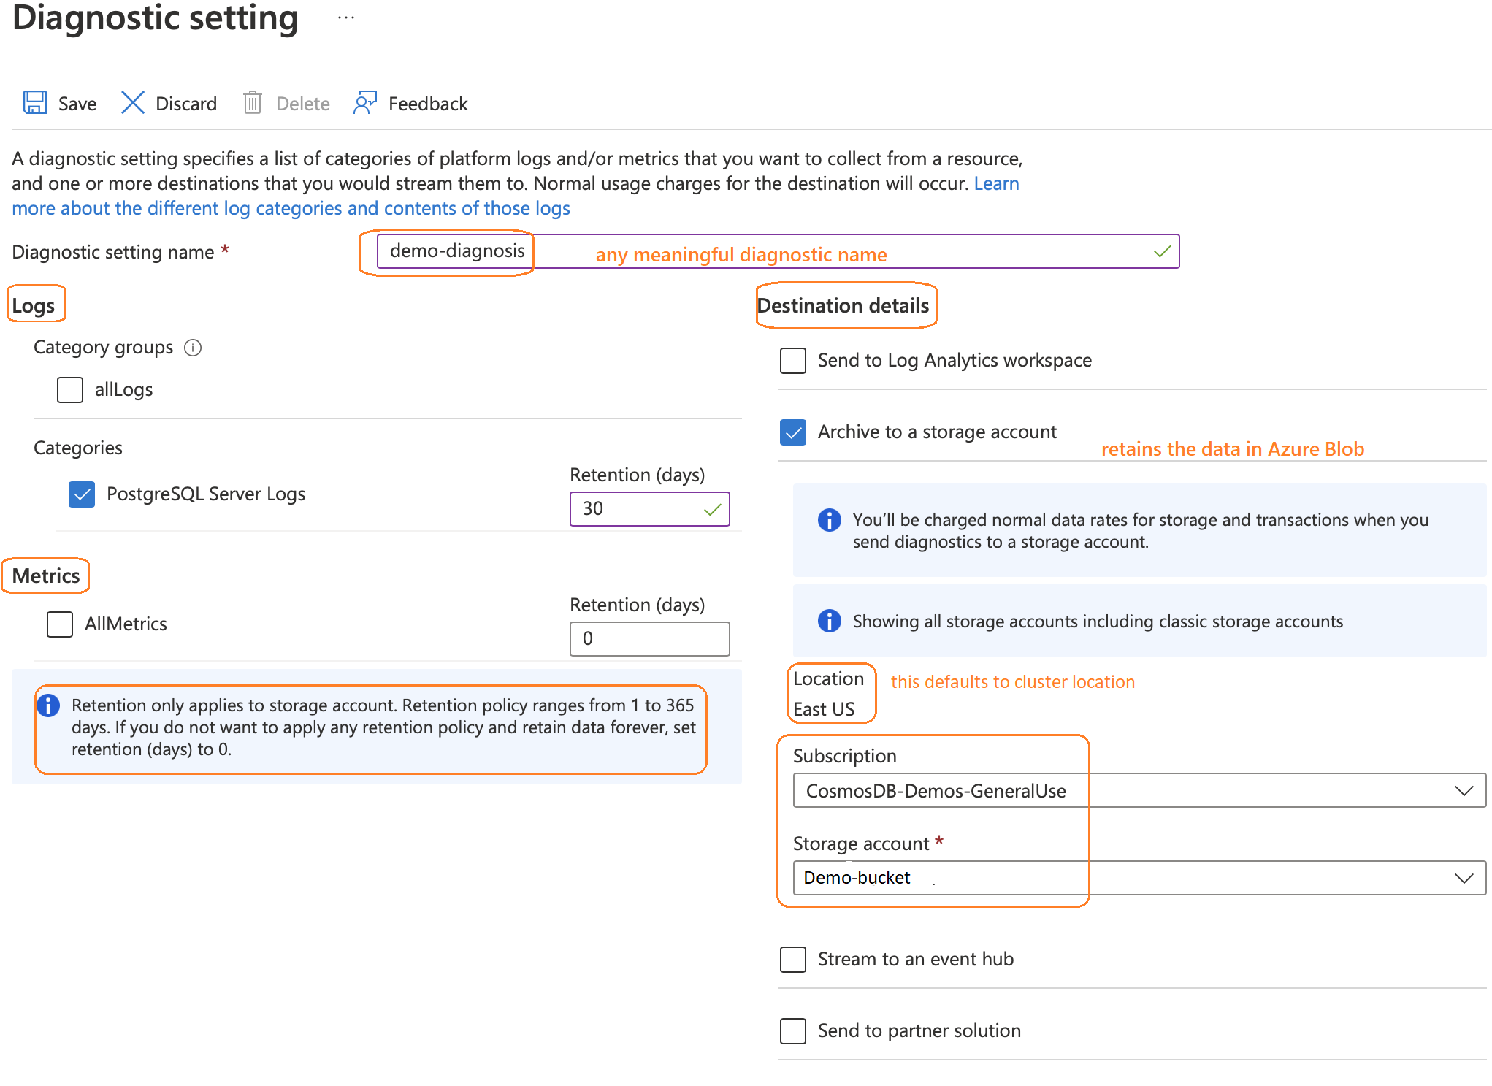
Log Analytics workspace to manage Logs
Notes:
Archiving to storage account permits us to retain pretty long term history
https://docs.microsoft.com/en-us/azure/azure-monitor/essentials/diagnostic-settings?tabs=portal

Slide 82
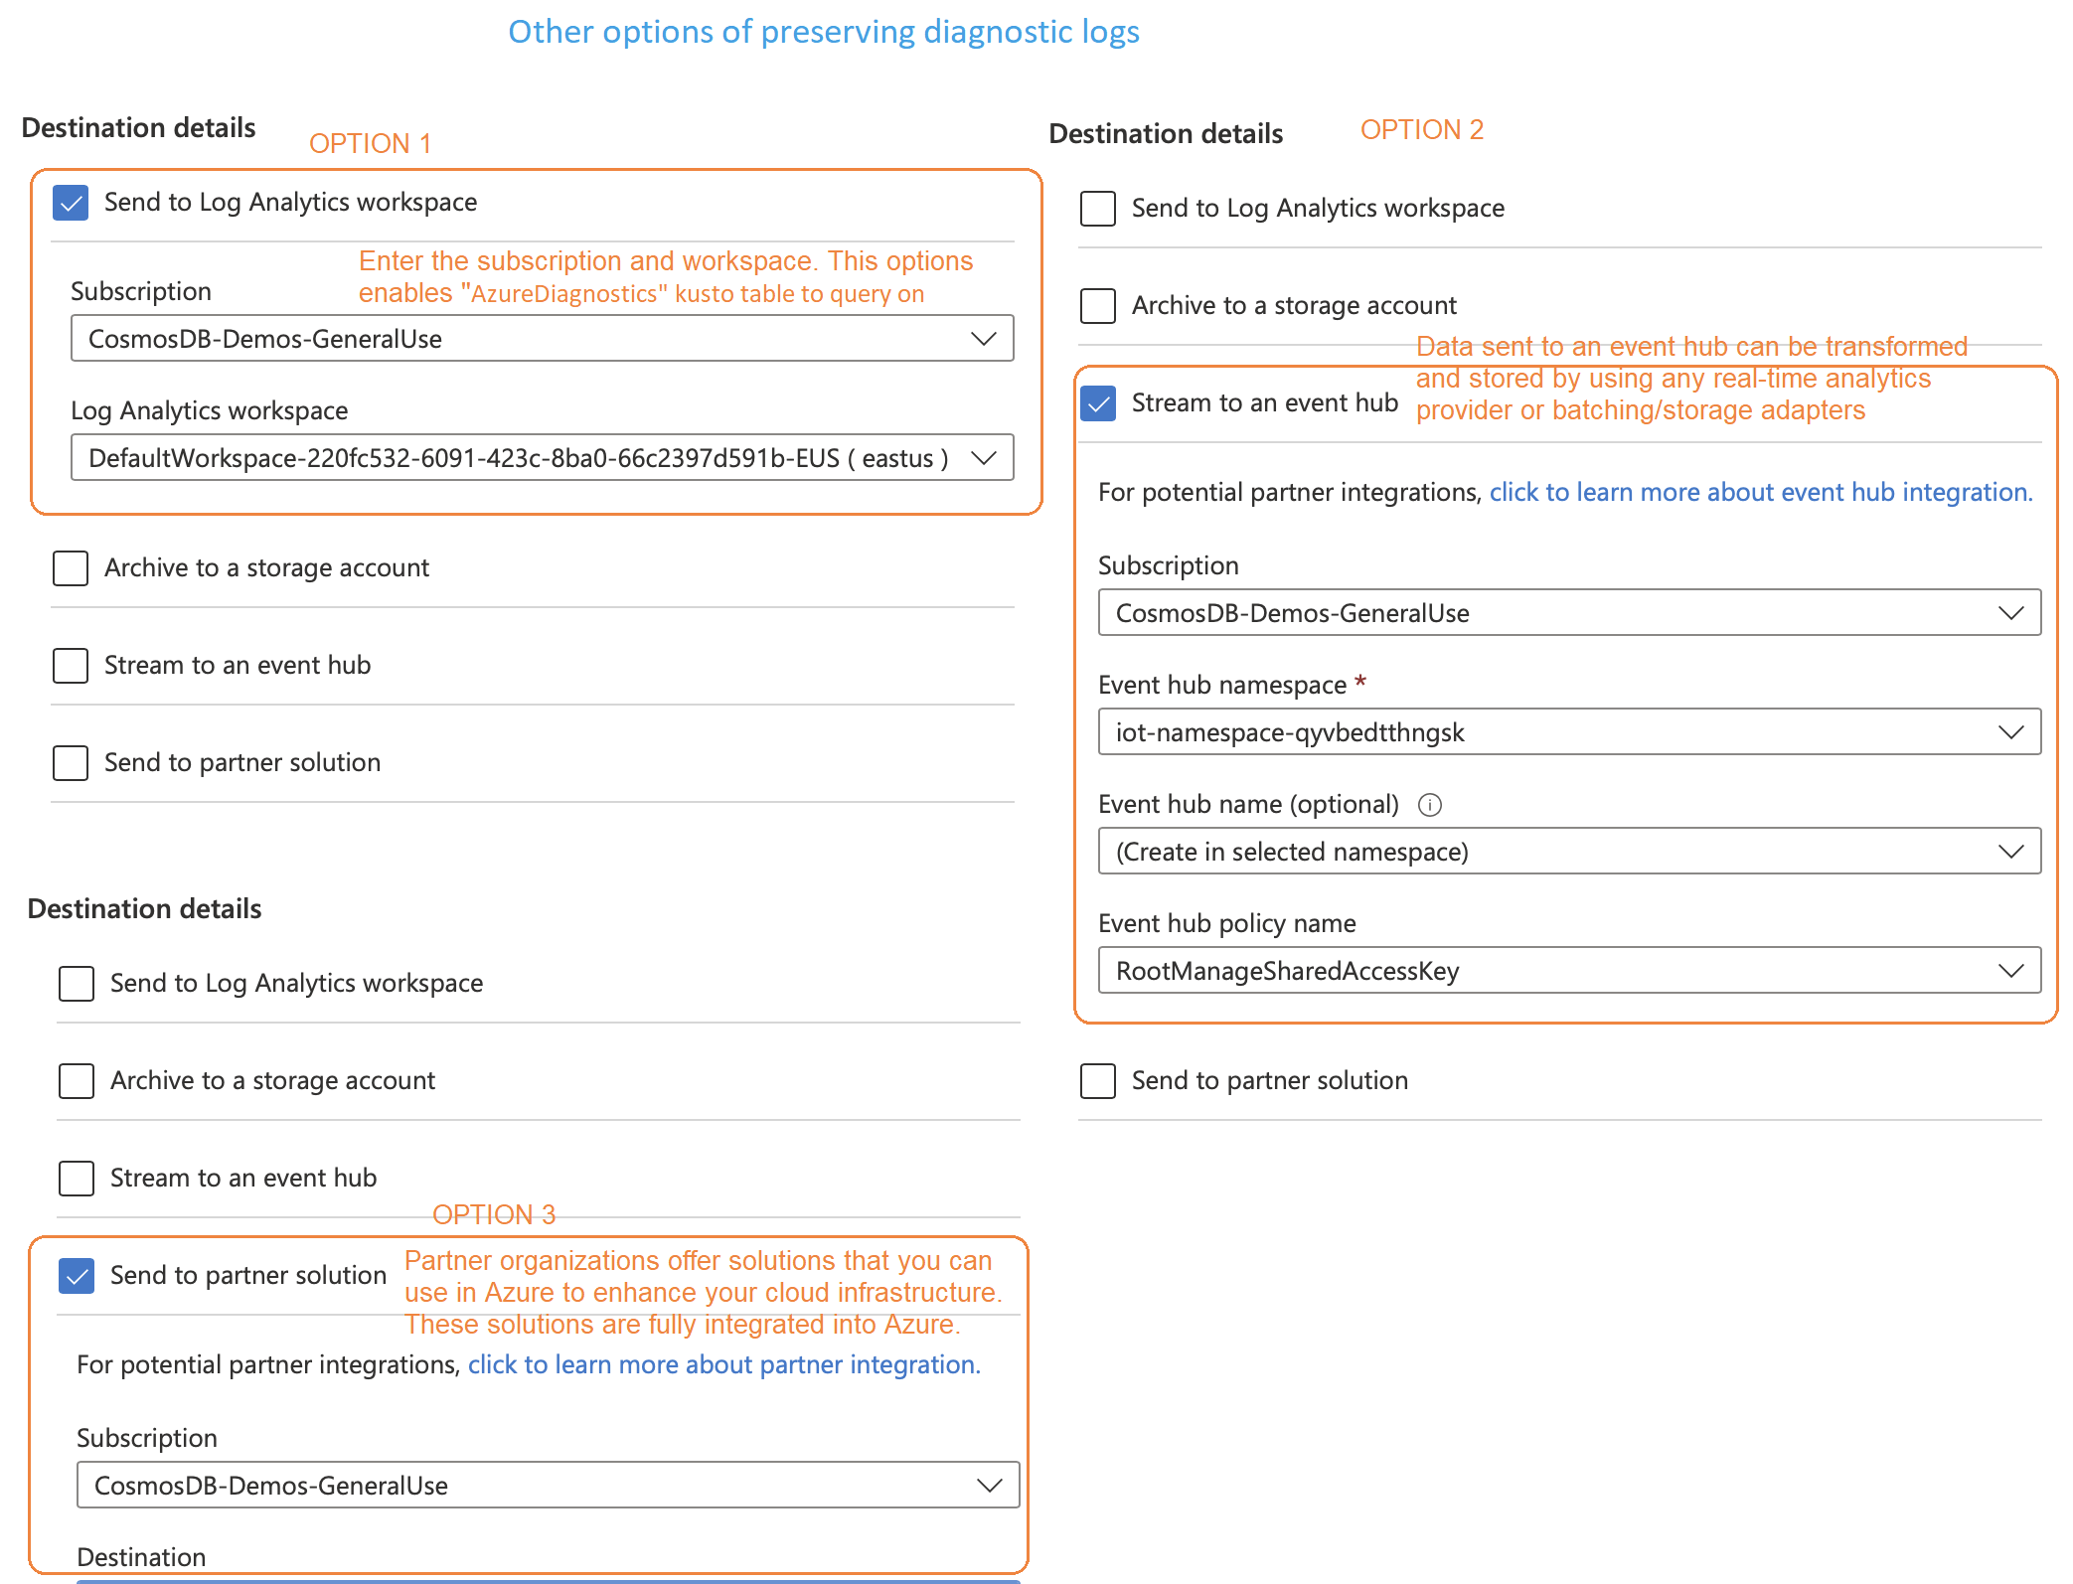
Log Analytics workspace to manage Logs contd…
Notes:
Archiving to storage account permits us to retain pretty long term history

Slide 83
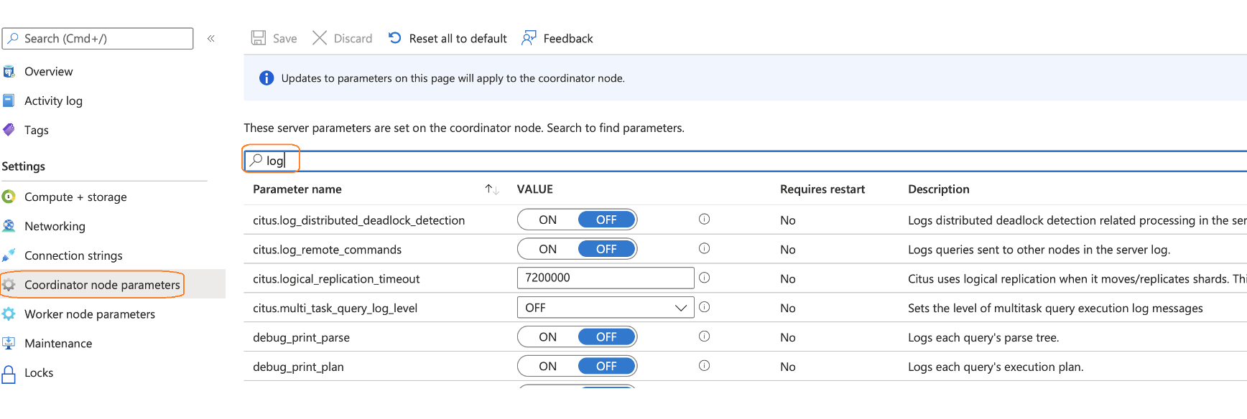
Navigate to Logging Parameters

Slide 84
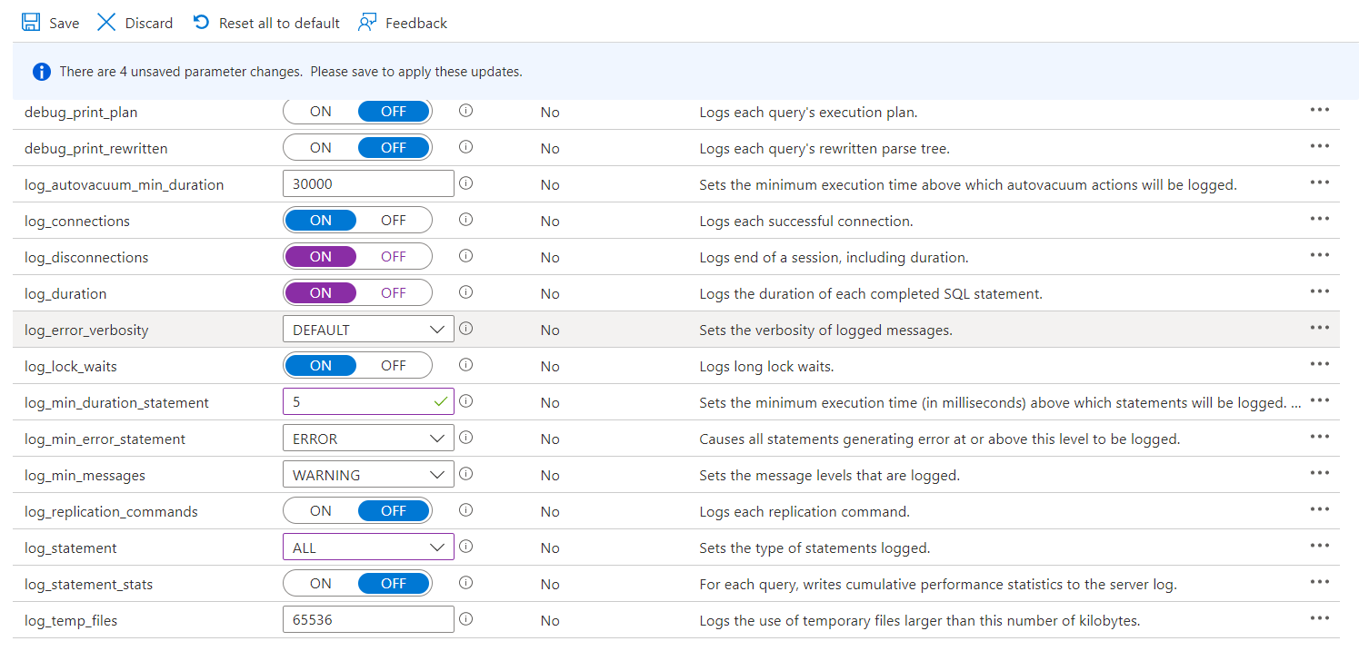
Configuring Logging Parameters
LOG_DISCONNECTIONS
Default: OFF LOG_DURATION
Default: OFF
LOG_MIN_DURATION_
STATEMENT
Default: 30000
To Disable set it to -1
LOG_STATEMENT
Default: NONE Other Options: DDL, MOD, ALL

Slide 85
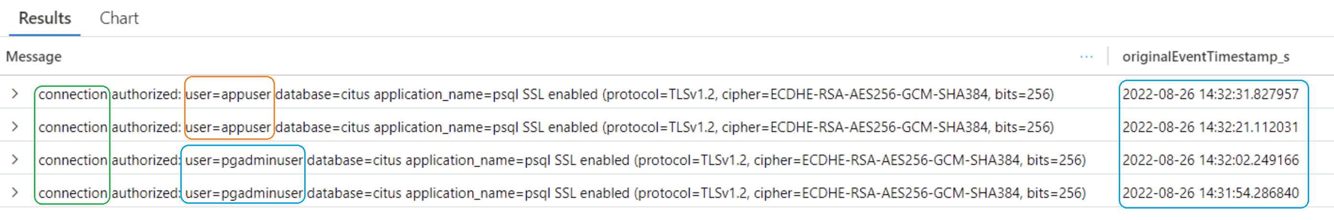
Reviewing Analytics Logs for Connections
Azure data explorer query to list all incoming connections for “appuser” & “pgadminuser”
AzureDiagnostics
| order by TimeGenerated desc
| where LogicalServerName_s == ”demo-all-tests-c"
| where TimeGenerated > ago(1d)
| where Message contains "connection authorized: user=appuser”
or Message contains "connection authorized: user=pgadminuser”
| project Message, originalEventTimestamp_s
| limit 100
Notes:
Some additional filters we may want to query on for digging deeper into understanding activity on server
Https://docs.microsoft.com/en-us/azure/postgresql/hyperscale/howto-logging

Slide 86
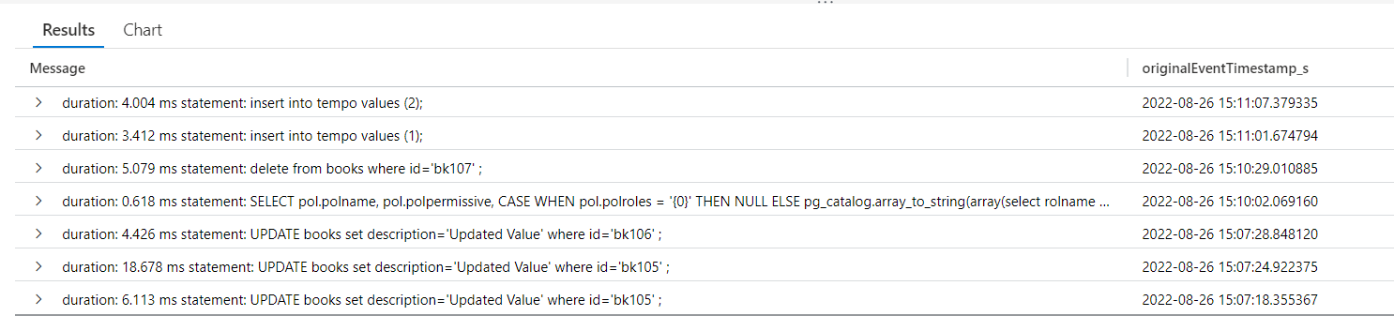
Reviewing Analytics Logs for DMLs
Azure Data Explorer query to list all the DML operations (system + user) performed on Citus server
AzureDiagnostics
| order by TimeGenerated desc
| where LogicalServerName_s == ”demo-hsc-all-tests-c"
| where Message contains "INSERT"
or Message has "SELECT"
or Message has "DELETE"
or Message has “UPDATE"
| project Message,originalEventTimestamp_s
| limit 100
Notes:
Effectively we could query for any specific scenario like : (Message field should contain those keywords)
Failure \ error (with code)
Rollback
Isolation level changes
Backup \ restore etc

Slide 87
PostgreSQL Extensions

Slide 88
PostgreSQL Extensions
Azure Cosmos DB for PostgreSQL supports several other important categories of Extentions :
Full Text Search extentions like dict_int
Geospatial extention like PostGIS
Functions extention like autoinc, intagg, intarray, pg_partman, uuid-ossp etc
Index Type extentions like btree_gin
DataType extentions like hstore, ltree, topn etc
Other Important extentions like pg_cron, pg_stat_statements, pageinspect etc

Slide 89
PostGIS extension real world use case
-- Creating extension on Citus
SELECT create_extension('postgis');
PostGIS – Extension adds support for geographic objects to the PostgreSQL object-relational database
Guy Carpenter – Provides data insights to major Insurance players across the world helping them analyse policies in different spheres like Reinsurance, Risk management & Financial management to its Clients. With sample queries like below they try to associate catastrophe dataset against Client’s policies dataset to perform real time spatial data analysis & identify the impact of such events
-- Query uses geometric datatypes & spatial function
SELECT COUNT(*) ,storm_name ,migration_source_name FROM policy_polygon_data p
JOIN catastrophe_data c WHERE st_intersect(p.shape,c.shape) and storm_name =‘IRMA’;
OR
WHERE st_dwithin(geography(p.shape), geography(c.shape),16090); -- helps to look in the vicinity of 16 miles.
Catastrophe may include Hurricane, Storms, Earthquakes, Wildfire, Flood etc
https://www.youtube.com/watch?v=vbDmwEgNFHs
Notes:
Most frequently used extensions and with an example.
Queries per extention. Extention is running in parallel across worker node.
https://docs.microsoft.com/en-us/azure/postgresql/hyperscale/reference-extensions

Slide 90
TopN & HLL extension real world use case
-- Creating extension on Citus
SELECT create_extension(‘TopN’);
TopN - Extension makes it easy to calculate the most frequently occurring values.
Algolia uses TopN to keep top items sorted by frequency. With TopN, Algolia's APIs can quickly find the most popular queries in a given time frame across the entire distributed database. This feature is useful for Algolia’s customers such as Hacker News, whose search is powered by Algolia.
SELECT index, topn_add_agg(query) AS top_searches, topn_add_agg(query) FILTER (WHERE nb_hits = 0) AS top_no_result_searches, topn_union_agg(top_hits) AS top_hits, hll_add_agg(hll_hash_text(user_id)) AS user_hll FROM searches;
SELECT
query,
hll_cardinality(hll_union_agg(user_hll))::bigint AS distinct_user_count
FROM
searches;
https://www.youtube.com/watch?v=vbDmwEgNFHs
Notes:
Most frequently used extensions and with an example.
Queries per extention. Extention is running in parallel across worker node.
https://docs.microsoft.com/en-us/azure/postgresql/hyperscale/reference-extensions

Slide 91
Customers

Slide 92

UK COVID-19 dashboard built using Postgres and Citus
While ministers and scientists can see individual data sets before the public, the dashboard itself is an example of truly democratized, open-access data: the latest graphs and someone sitting at home in Newcastle sees the latest trends and graphs for the first time at 4pm, the same moment as the Prime Minister in his office in Downing Street does.
The number of concurrent users at peak is 60,000 to 100,000 depending on day and prevalence—and that’s just the people browsing the actual website.
Support for the Python ORM mattered.
The need for High Availability (HA) drove UKHSA to use a managed database service in the cloud.
Postgres support for JSON and JSONB is more than just a crowd favourite.
250,000 to 300,000 hits per minute at peak.
concurrent users at peak is 60,000 to 100,000
7.5 billion records
5 million data points returned in under 10 seconds
Cache invalidation durations never exceed 2 minutes.
https://techcommunity.microsoft.com/t5/azure-database-for-postgresql/uk-covid-19-dashboard-built-using-postgres-and-citus-for/ba-p/3036276
Notes:
Example includes usage of time series + Real-time Analytics (HTAP)
Key parameter properties :
max_locks_per_transaction
citus.task_assignment_policy round-robin policy
citus.max_adaptive_executor_pool_size to 1
Citus distributed database cluster adopted by the team on Azure is HA-enabled for high availability and has 12 worker nodes with a combined total of 192 vCores, ~1.5 TB of memory, and 24 TB of storage. (The Citus coordinator node has 64 vCores, 256 GB of memory, and 1 TB of storage.)

Slide 93

MixRank Gets Faster Performance & Huge Cost Savings with the Citus Database
MixRank is the Customer Discovery Platform that helps business-to-business (B2B) inside sales teams find new customers. It is the fastest way for sales reps to build prospect lists, prioritize leads, and contact decision makers.
“The Citus open source extension to Postgres, deployed on a 20-node Citus cluster with SSDs, has enabled us to achieve phenomenal I/O parallelism and I/O throughput. We have been able to dramatically increase performance and also to cut costs. Citus has been a competitive and operational game-changer for our business.”
The most obvious benefit of the shift to Citus was that customers immediately began seeing fresher data. Because Citus did not need to pre-compute as many elements as before, customers began seeing data from minutes or even seconds before their queries. “Most of our competitors still rely on daily batch updates, which makes the Citus database a huge competitive differentiator for us.
1.6 PB of time series data, including cold data
3 petabytes (3 PB) of data processed every month.
50-100 times smaller hardware budget
Data available in real-time
https://www.citusdata.com/customers/mixrank
Notes:
PG-API snaps

Slide 94
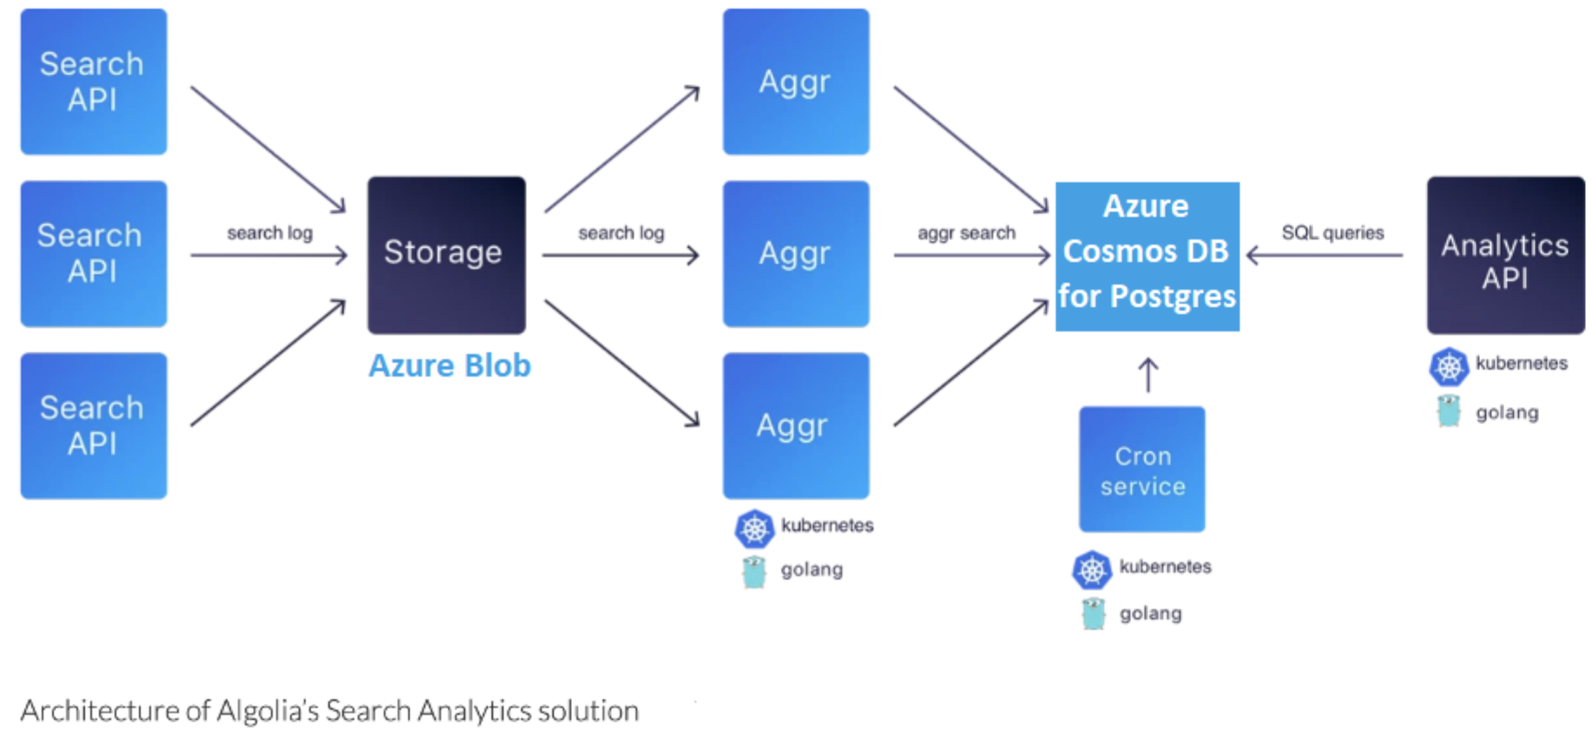

With Citus, Algolia Speeds Up Search Analytics & Eradicates Database Management Headaches
Algolia hosts search as a service to power search-based tools on their own websites and apps. Algolia also provides its customers with a variety of analytics about their end users’ search behaviors.
Citus handles our complex ingest and delete operations seamlessly—and that’s with a workflow that creates five to ten billion new rows of data per day. The way in which Citus shards and distributes data across multiple nodes has given us the parallelization we need.
TopN is an open source extension to Postgres, created by Citus Data. Algolia uses TopN to calculate the most frequently occurring values in a column so they can keep top items sorted by frequency.
https://youtu.be/QbojoPywO8g
Notes:
PG-API snaps

Slide 95
Scale for Algolia’s Analytics platform
Challenges
Analytics on Real-time data suffered.
Reliability was challenge with Elastic Search Cluster.
Estimation of pricing. Pricing for BigQuery was based on amount of data scanned.
Clickhouse was ruled out due to missing managed cloud offering.
Limitation to algorithm support like TopN & HyperLogLog (available through extension in PG)
Impact
Response times for 95% of queries are less than 800 milliseconds.
Citus Cloud enables Algolia to provide analytics at scale, for over 1B searches per day
Support with high ingestion rate 5-10 Bn per day.
Went from frequent downtime with previous analytics solution—to no downtime with the Citus Cloud database
Clearer cost estimation.
1.6 PB of time series data, including cold data
3 petabytes (3 PB) of data processed every month.
50-100 times smaller hardware budget
Data available in real-time
https://youtu.be/QbojoPywO8g
Notes:
PG-API snaps

Slide 96
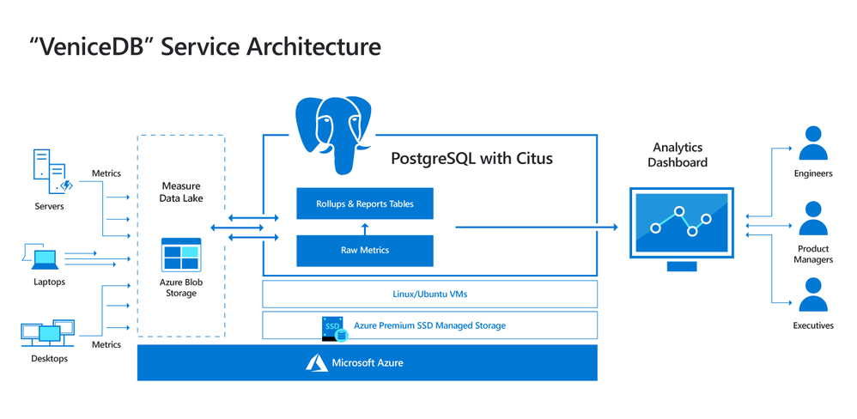
Microsoft Windows relies on Hyperscale (Citus) for mission-critical decisions
“Ship/no-ship decisions for Microsoft Windows are made using Hyperscale (Citus), where our team runs on-the-fly analytics on billions of JSON events with sub-second responses.
Distributed PostgreSQL is a game changer.”
1 PB+ data​​
20,000 diagnostic metrics
6M+ queries per day;
75% of queries completing < 0.2 secs
2,816 Cores and 18.7 TB ​of RAM
https://techcommunity.microsoft.com/t5/Azure-Database-for-PostgreSQL/Architecting-petabyte-scale-analytics-by-scaling-out-Postgres-on/ba-p/969685

Slide 97
Marsh Mclennan (MMC) (Americas/United States)​
Guy Carpenter, Advantage Point​
GC Advantage Point – the industry's most advanced spatial analytics platform for event response, underwriting and portfolio management. ​Helps their clients (large insurance firms) translate vast amount of geospatial data to insights required for hazard (like earthquakes) prediction, impact of hazard in an area and other mission critical features.​
Easier Migration of Netezza (Postgres-XL). Highly require a scalable distributed PostgreSQL database.
Extension nature of Citus – lets them leverage latest innovations in PostgreSQL (PostGIS).
PaaS nature of Citus – “no need to worry of maintenance” ​
~30TB data size and growing drastically.
Workload has 3000 global users, with 10-50 of them concurrently performing complex geospatial analysis
Data available in real-time
https://www.youtube.com/watch?v=vbDmwEgNFHs
Notes:
PG-API snaps

Slide 98
Migration

Slide 99
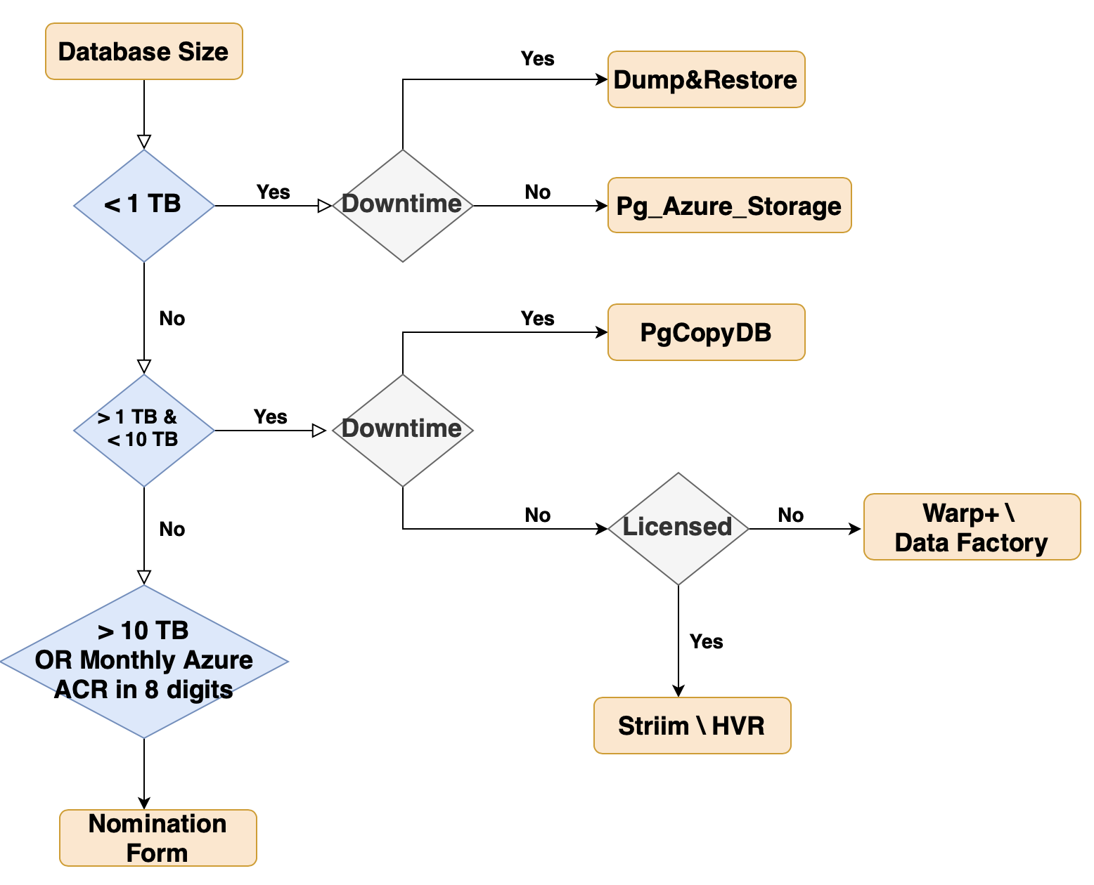
Homogeneous Migration Toolset
Notes:
Nomination Form : https://forms.office.com/Pages/ResponsePage.aspx?id=v4j5cvGGr0GRqy180BHbR3lvCd063bxNm5PGdK4SS7dUN1JNUkhBMkNJTEpQWVk1ODJPSzVRTlQwNi4u

Slide 100







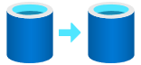

Hetrogeneous Migration
Post-migration
Optimize
Based on the tests you performed, address any performance issues, and then retest to confirm the performance improvements
Pre-migration
Migration
Discover
Assess
Convert
Migrate schema, data & objects
Data sync
Cutover
Remediate applications
Iteratively make any necessary changes to your applications
Inventory database assets, and application stack discovery
Assess workloads and fix recommendations
Convert the source schema to work in the target environment. This is only relevant for heterogeneous migrations.
Migrate the source schema, and then migrate the source data to the target
Sync your target schema and data with the source. This is only relevant for minimal-downtime migrations
Cut over from the source to the target environment. This is only relevant for minimal-downtime migrations
Run functional & performance tests
Iteratively run functional and performance tests
ora2pg
DMAT
SQLines
Ispirer
Pitss
EPAM
UnifyCloud
Newt Global
Striim
HVR
DMVA
Newt Global
Tooling →

Slide 101
App Stacks

Slide 102

Frameworks & Languages Parity
Language | Citus | Postgres | Reference
Java |  |  | https://docs.microsoft.com/en-us/azure/postgresql/hyperscale/quickstart-app-stacks-java
Python |  |  | https://docs.microsoft.com/en-us/azure/postgresql/hyperscale/quickstart-app-stacks-python
C# |  |  | https://docs.microsoft.com/en-us/azure/postgresql/hyperscale/quickstart-app-stacks-csharp
Node.js |  |  | https://docs.microsoft.com/en-us/azure/postgresql/hyperscale/quickstart-app-stacks-nodejs
Ruby |  |  | https://docs.microsoft.com/en-us/azure/postgresql/hyperscale/quickstart-app-stacks-ruby
Go |  |  | Official documentation yet to be added
C |  |  | Official documentation yet to be added
C++ |  |  | Official documentation yet to be added
Ruby on Rails |  |  | https://docs.citusdata.com/en/stable/develop/migration_mt_ror.html
Django |  |  | https://docs.citusdata.com/en/stable/develop/migration_mt_django.html
Asp.net |  |  | https://docs.citusdata.com/en/stable/develop/migration_mt_asp.html

Slide 103
Learn more

Slide 104
Learning Resources
Docs : https://learn.microsoft.com/azure/cosmos-db/postgresql/introduction
Free Trial : https://aka.ms/trycosmosdb
Citus community resources:
Blog : https://www.citusdata.com/blog/
Newsletter : https://www.citusdata.com/join-newsletter
Please fill the Nomination form and share it on cdbpg@microsoft.com , for larger opportunity size.
Criteria :
Data size : Greater than 10 TB
MS contracts in 8 digits
Cluster in place and shorter time frame to go live
Nomination Form : https://aka.ms/cdbpostgreshelp
Notes:
Pre-launch : https://review.learn.microsoft.com/en-gb/azure/cosmos-db/postgresql/introduction?branch=release-ignite-cosmosdb-pg

Slide 105
Closure

